Slide 1
Tsute (George) Chen Bioinformatics Core Department of Microbiology The Forsyth Institute March 24th, 2015
HOMD
A Tour to the Data and Tools

Slide 2
http://www.homd.org
ftp://ftp.homd.org
Google: HOMD
human oral microbiome database

Slide 3
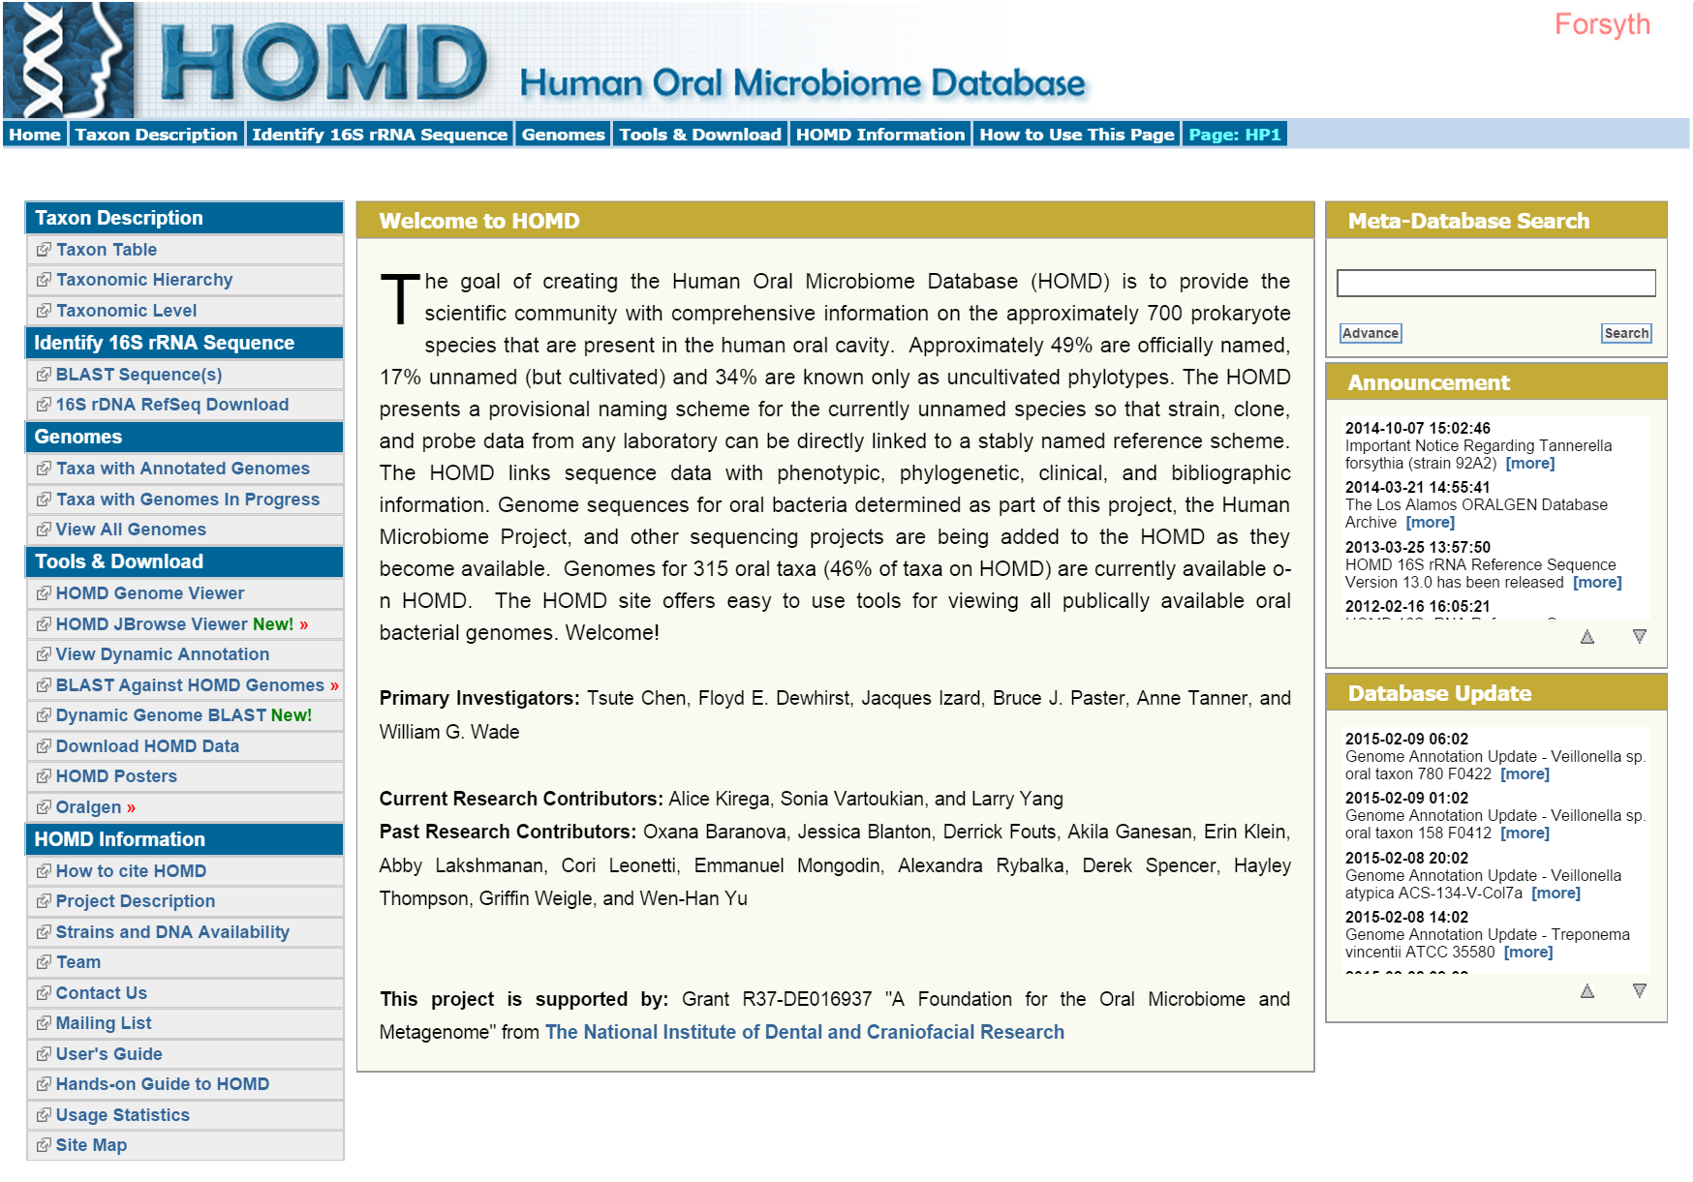

Slide 4
Taxonomy
Identify and study organisms
…..
Genomics
Biological functions
…..

Slide 5
707 taxa/species
Defined at 98.5% 16S rRNA sequence similarity
381 (54%) with at least one genomic sequence

Slide 7
Streptococcus

Slide 8
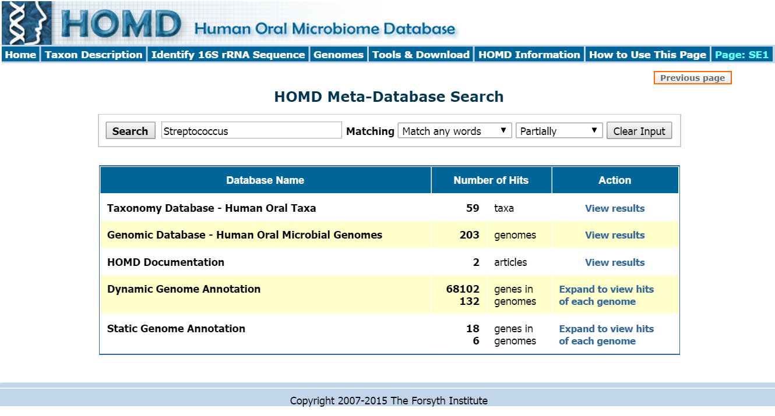

Slide 10
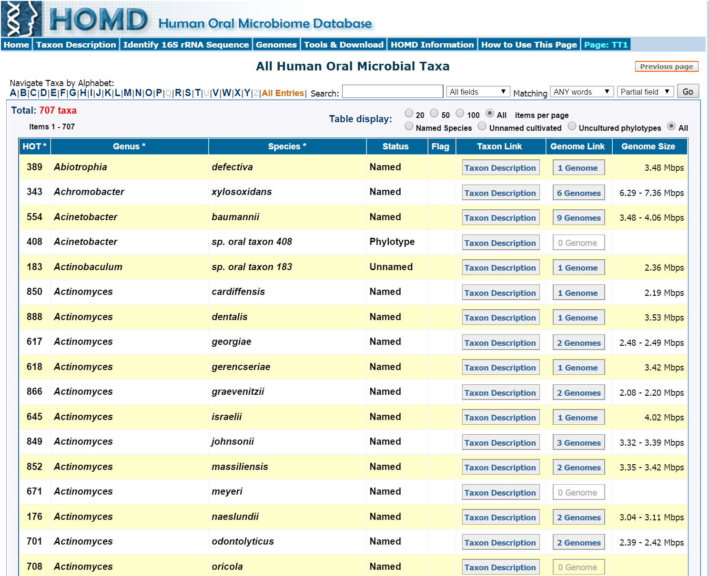

Slide 11
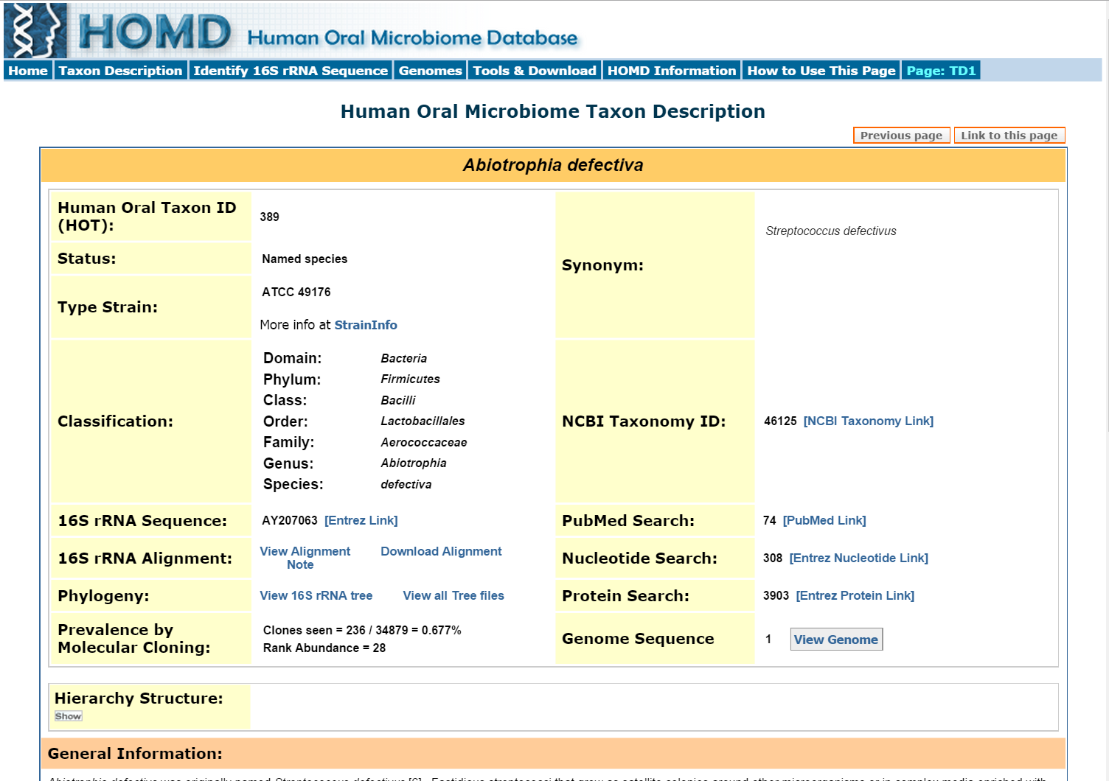

Slide 12
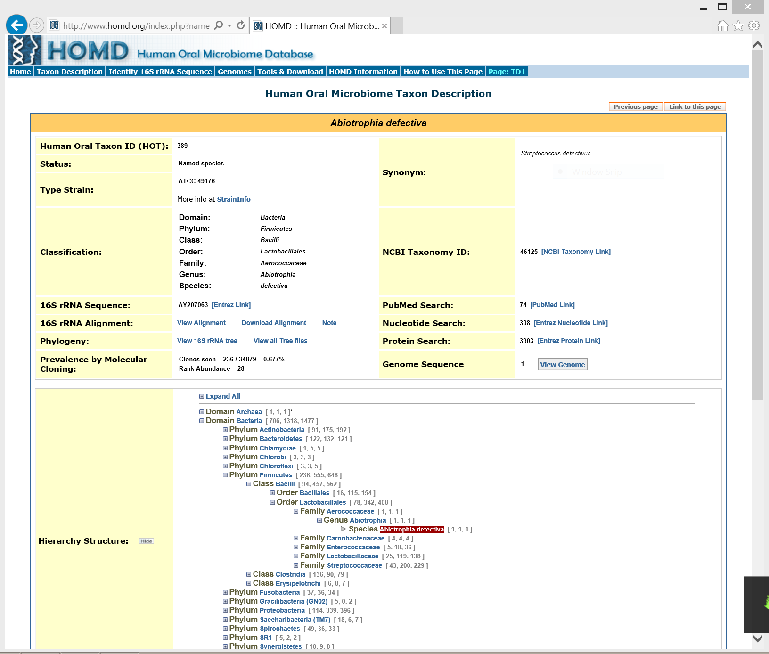

Slide 14
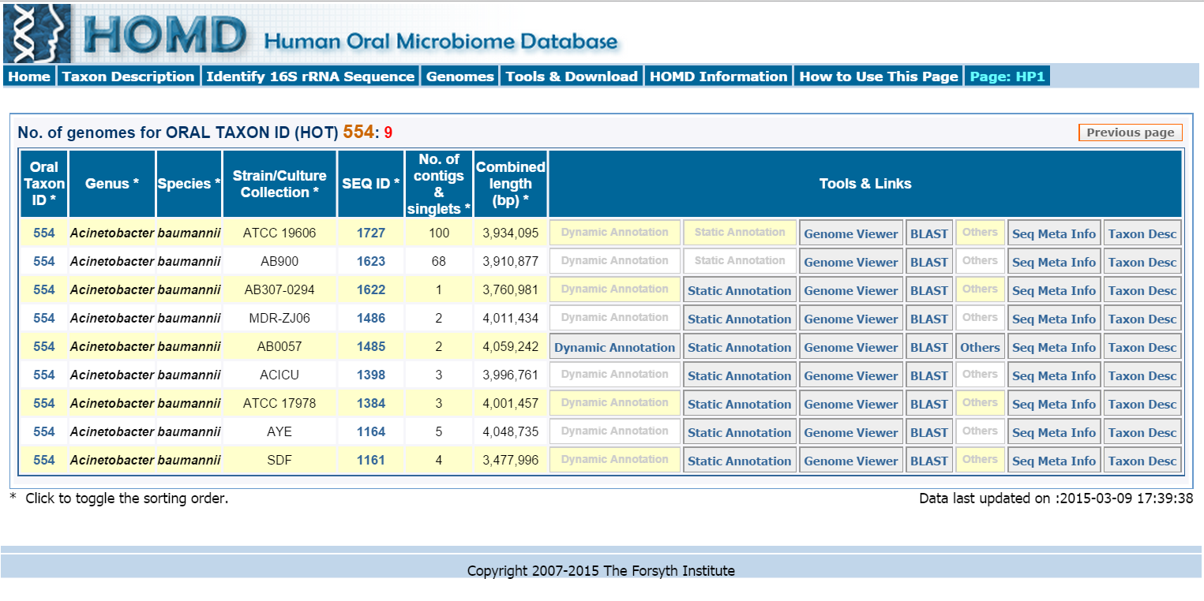

Slide 16
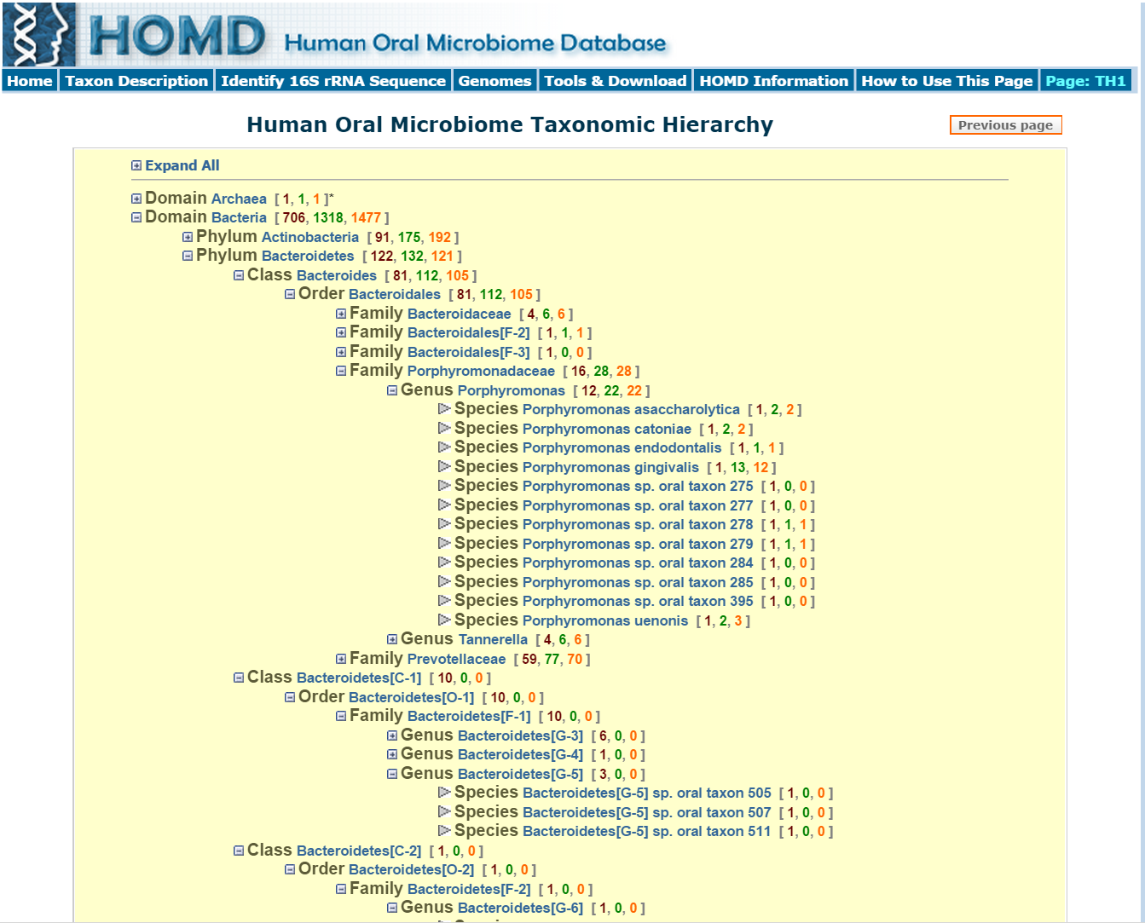

Slide 18
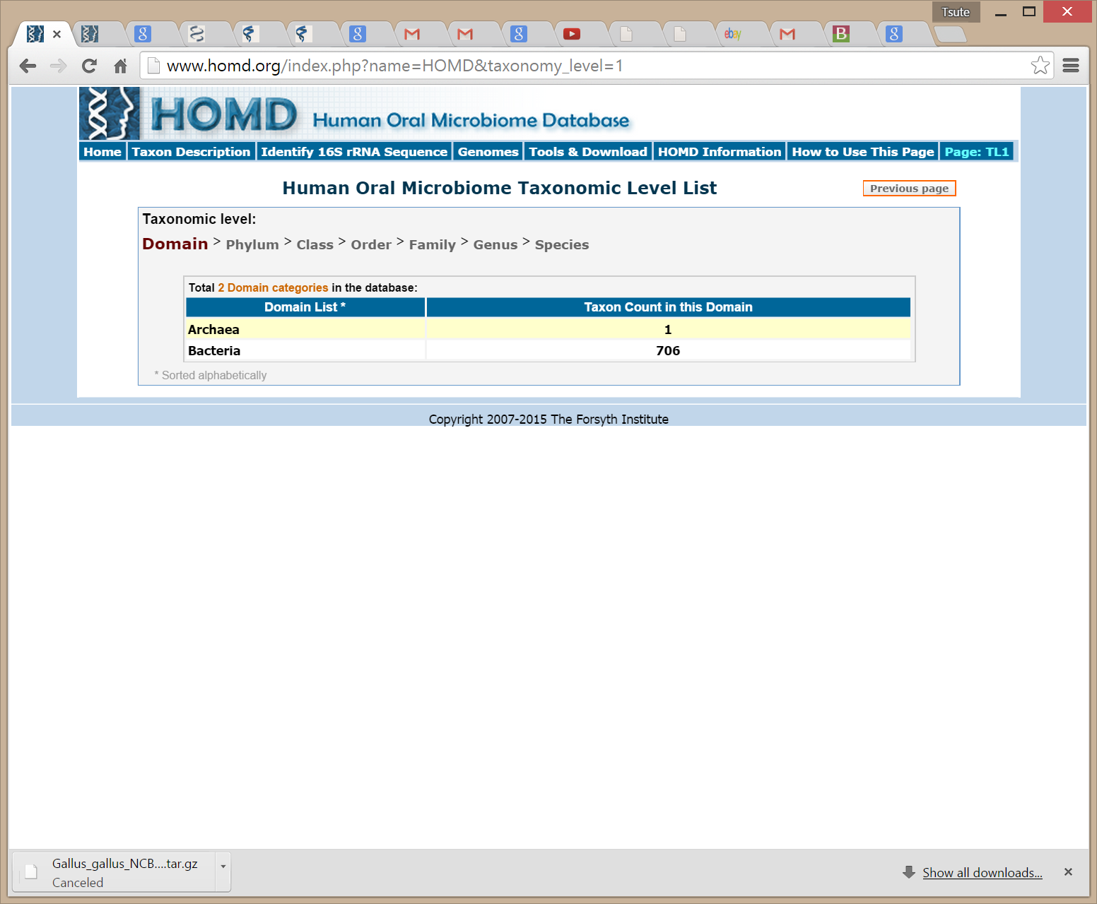

Slide 19
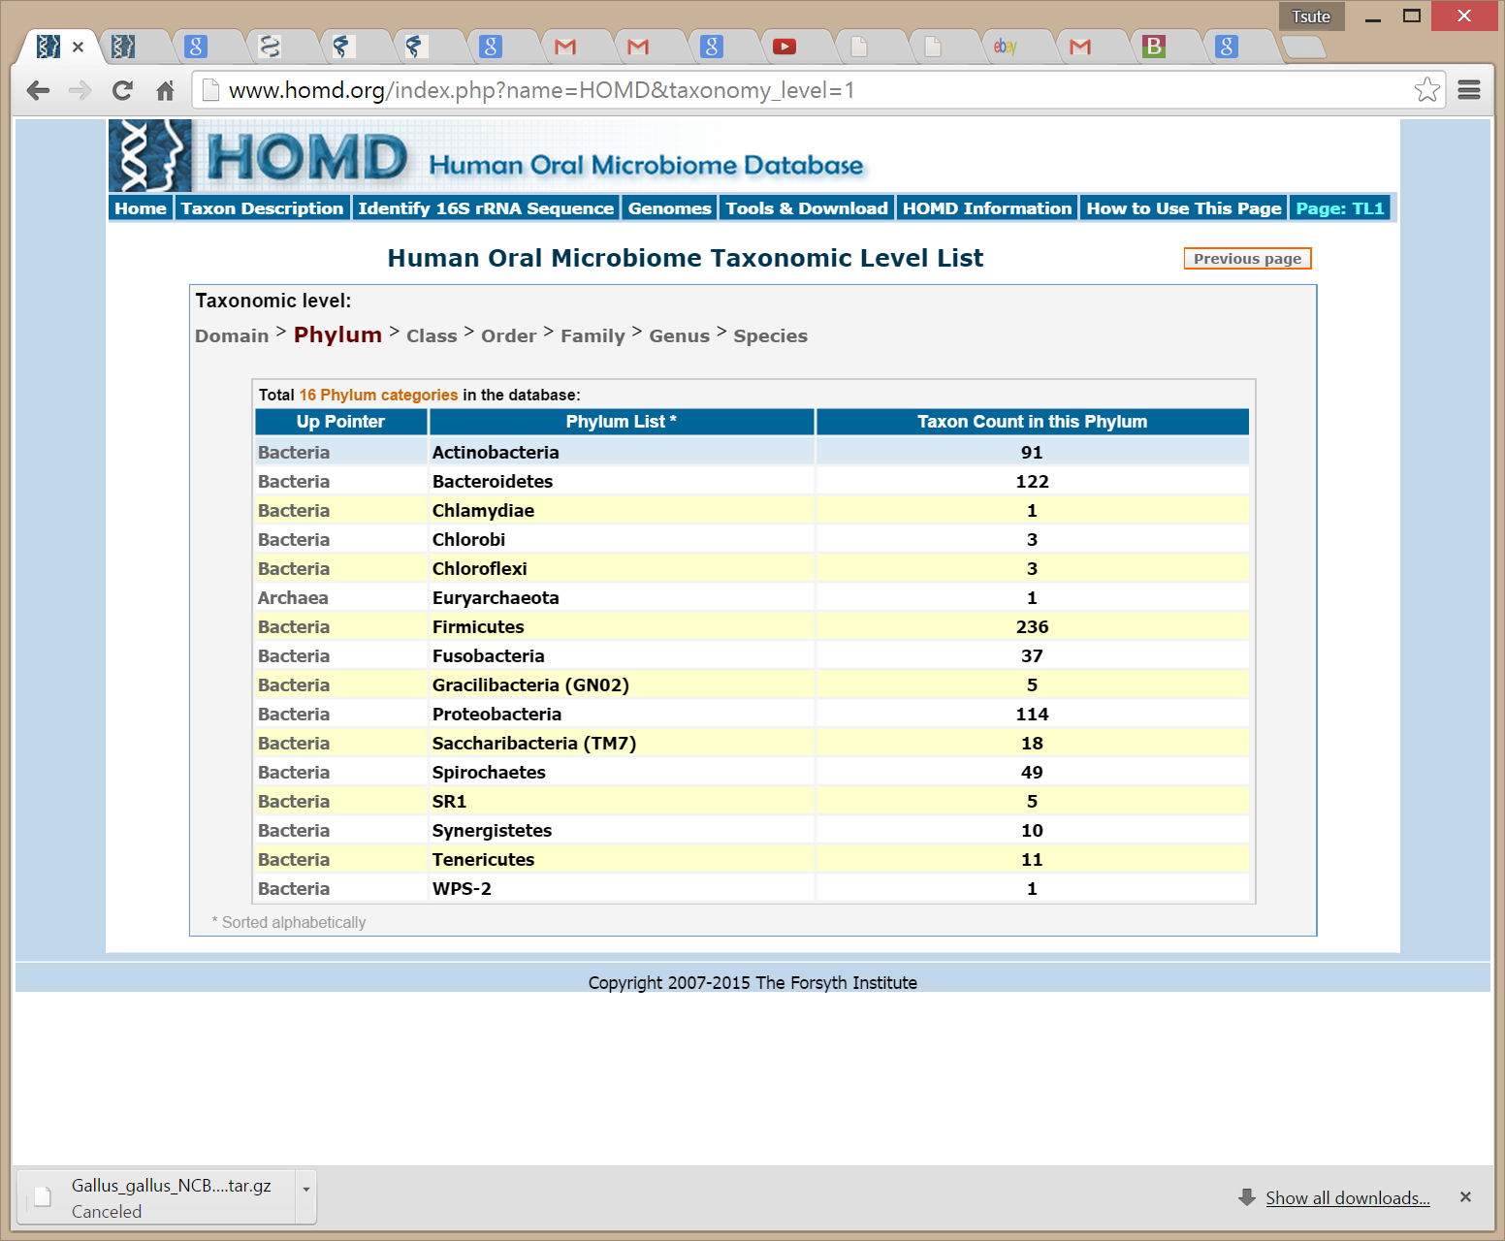

Slide 20
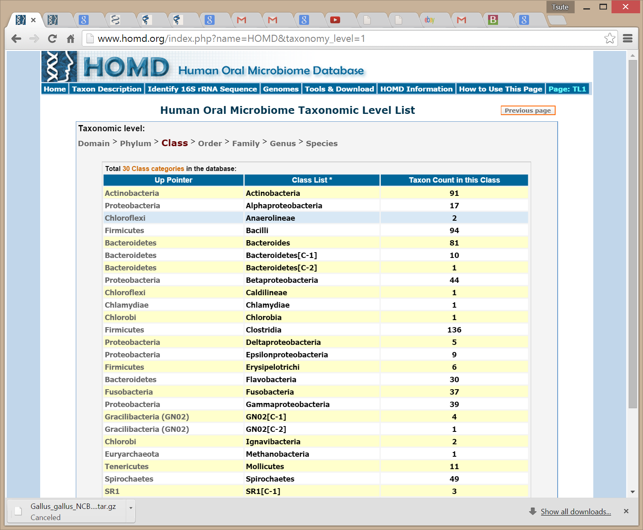

Slide 21
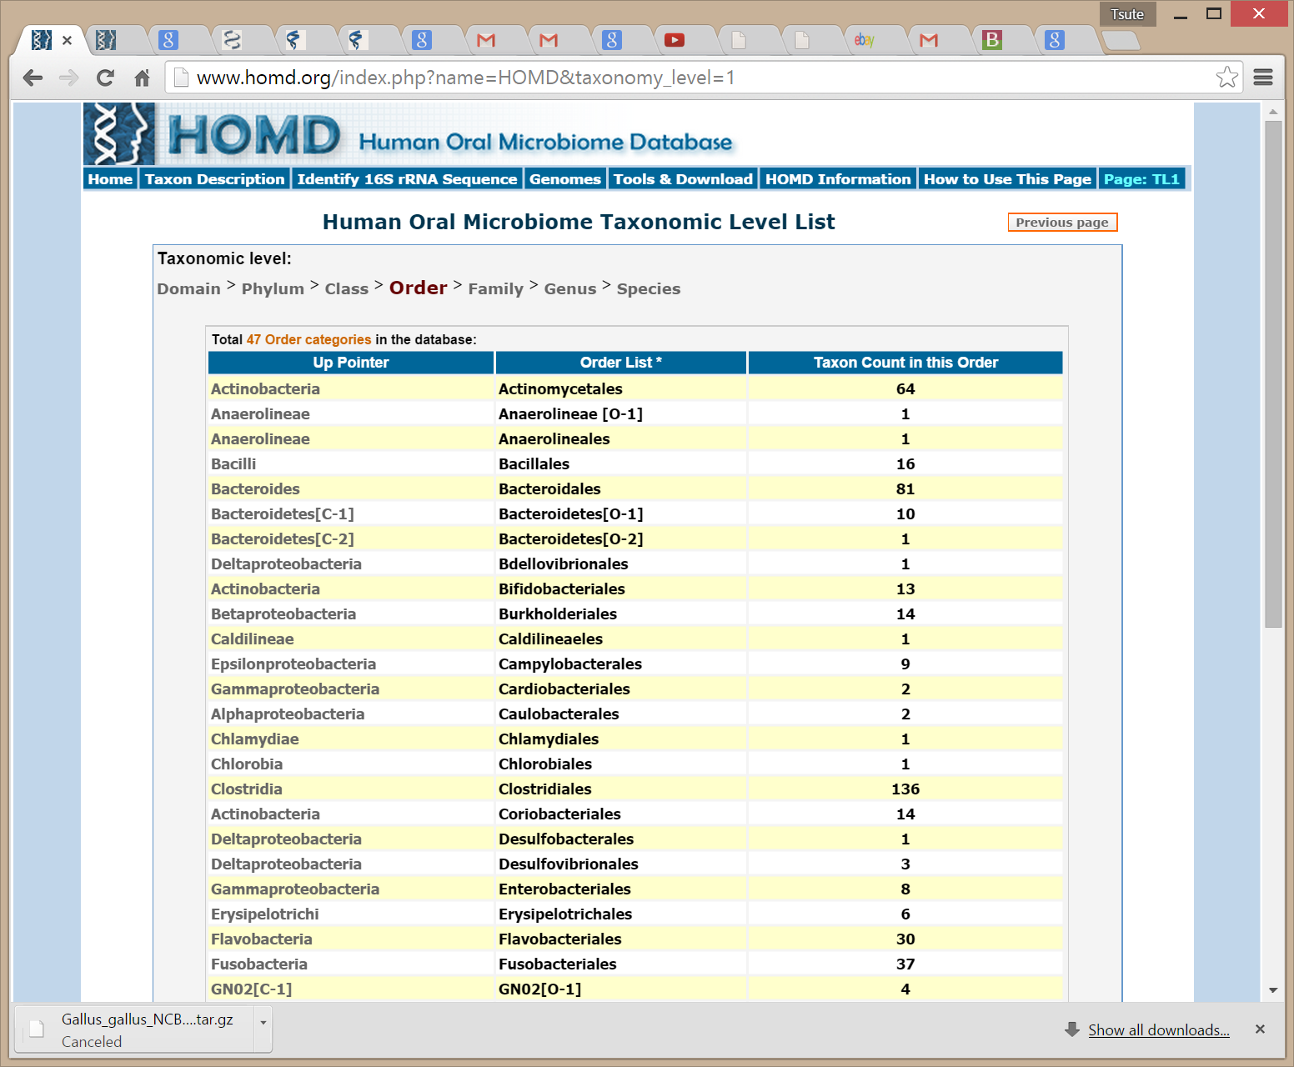

Slide 22
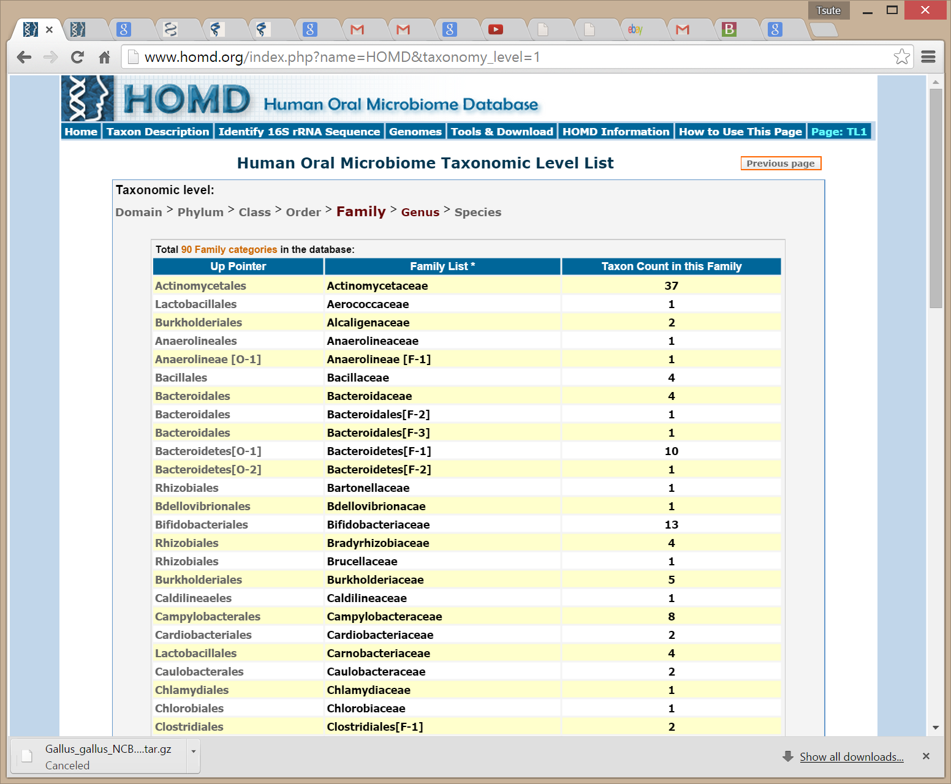

Slide 23
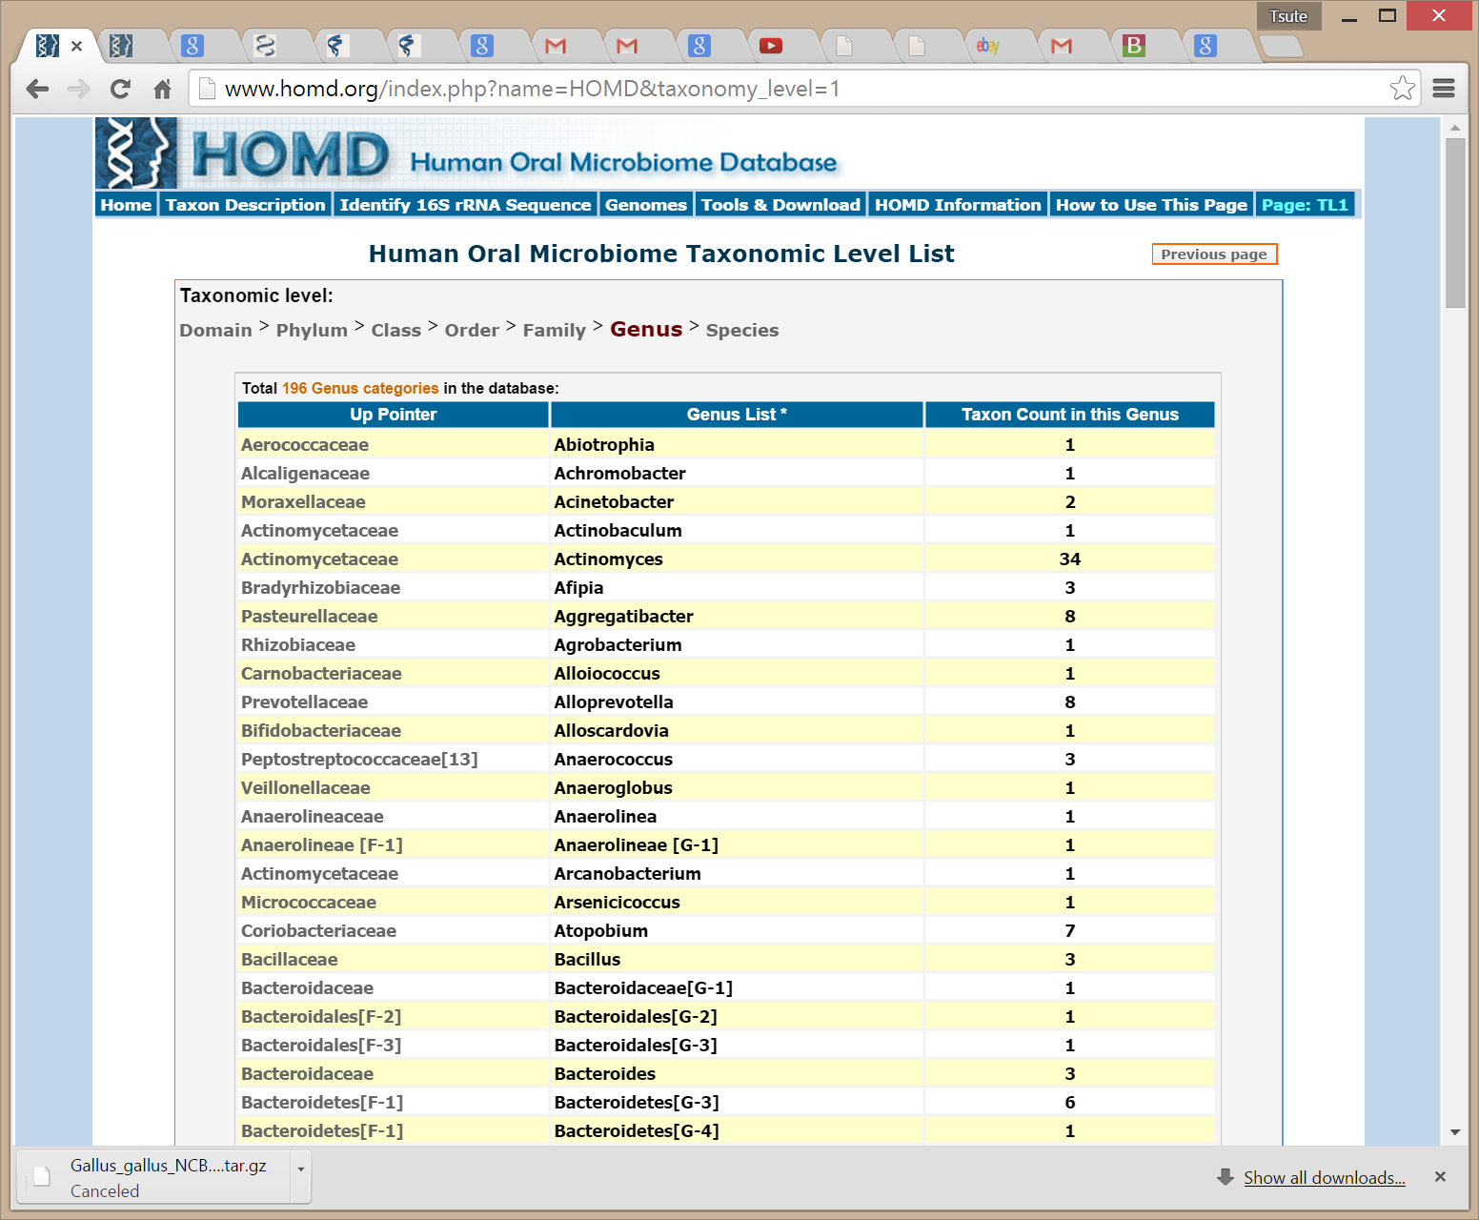

Slide 24
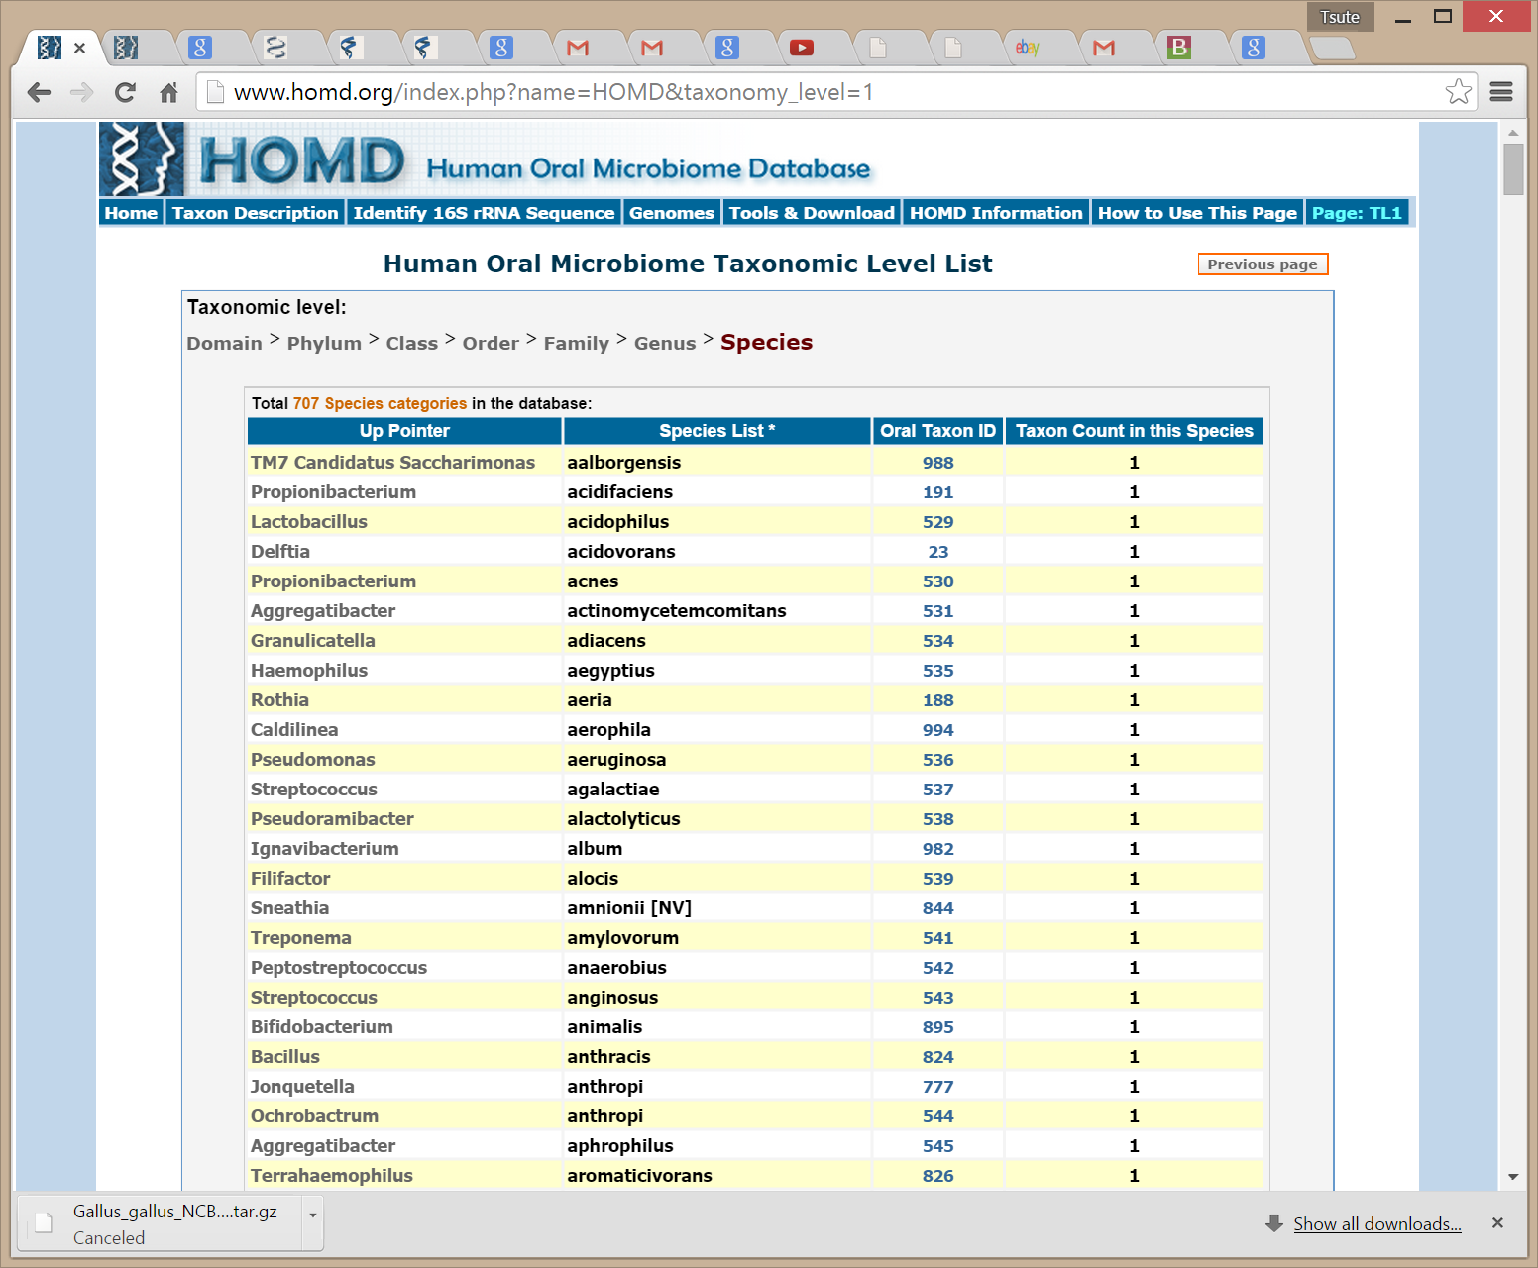

Slide 26
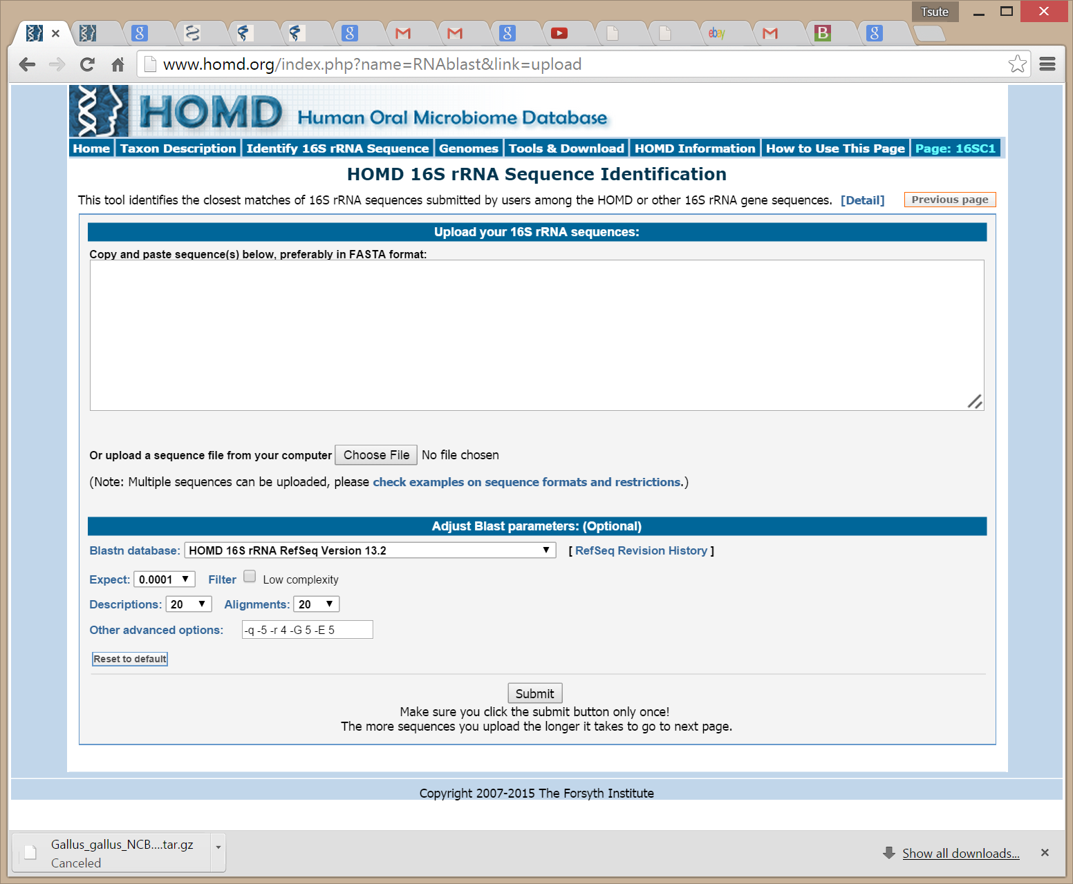

Slide 27
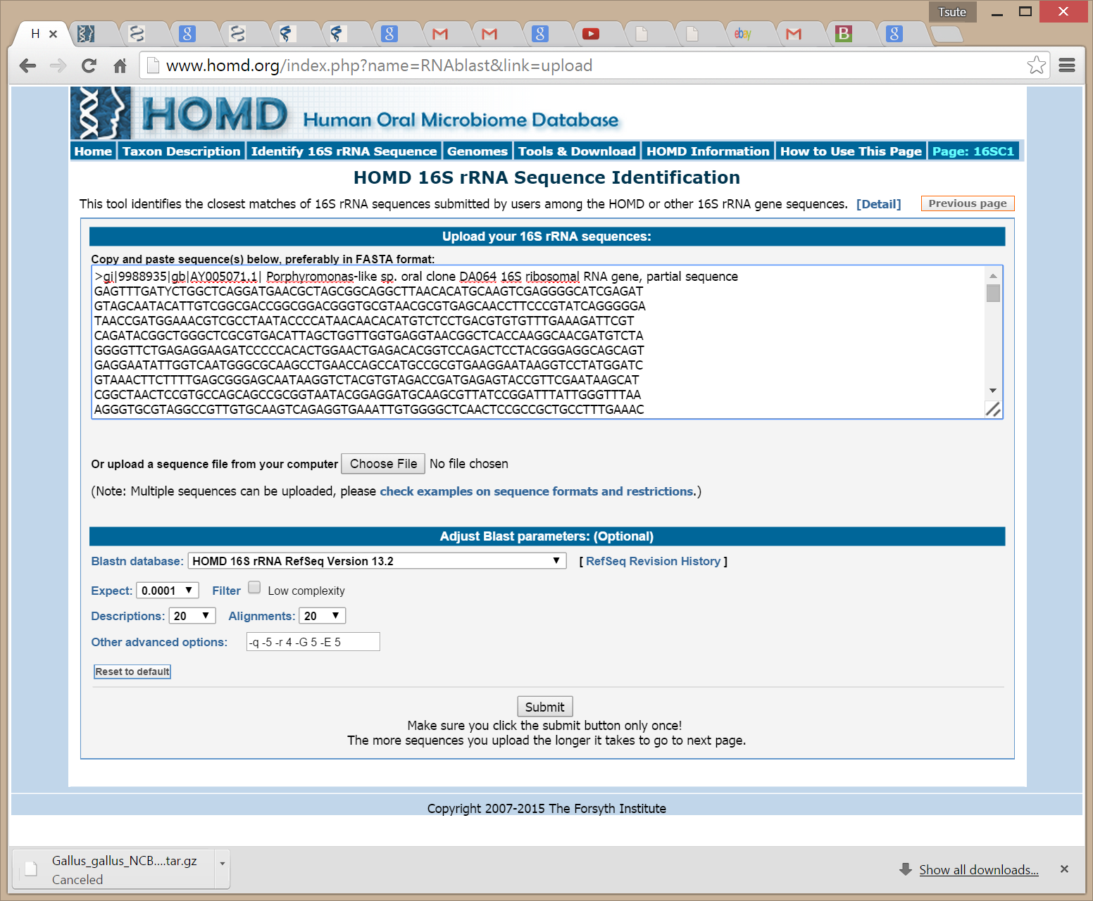

Slide 28
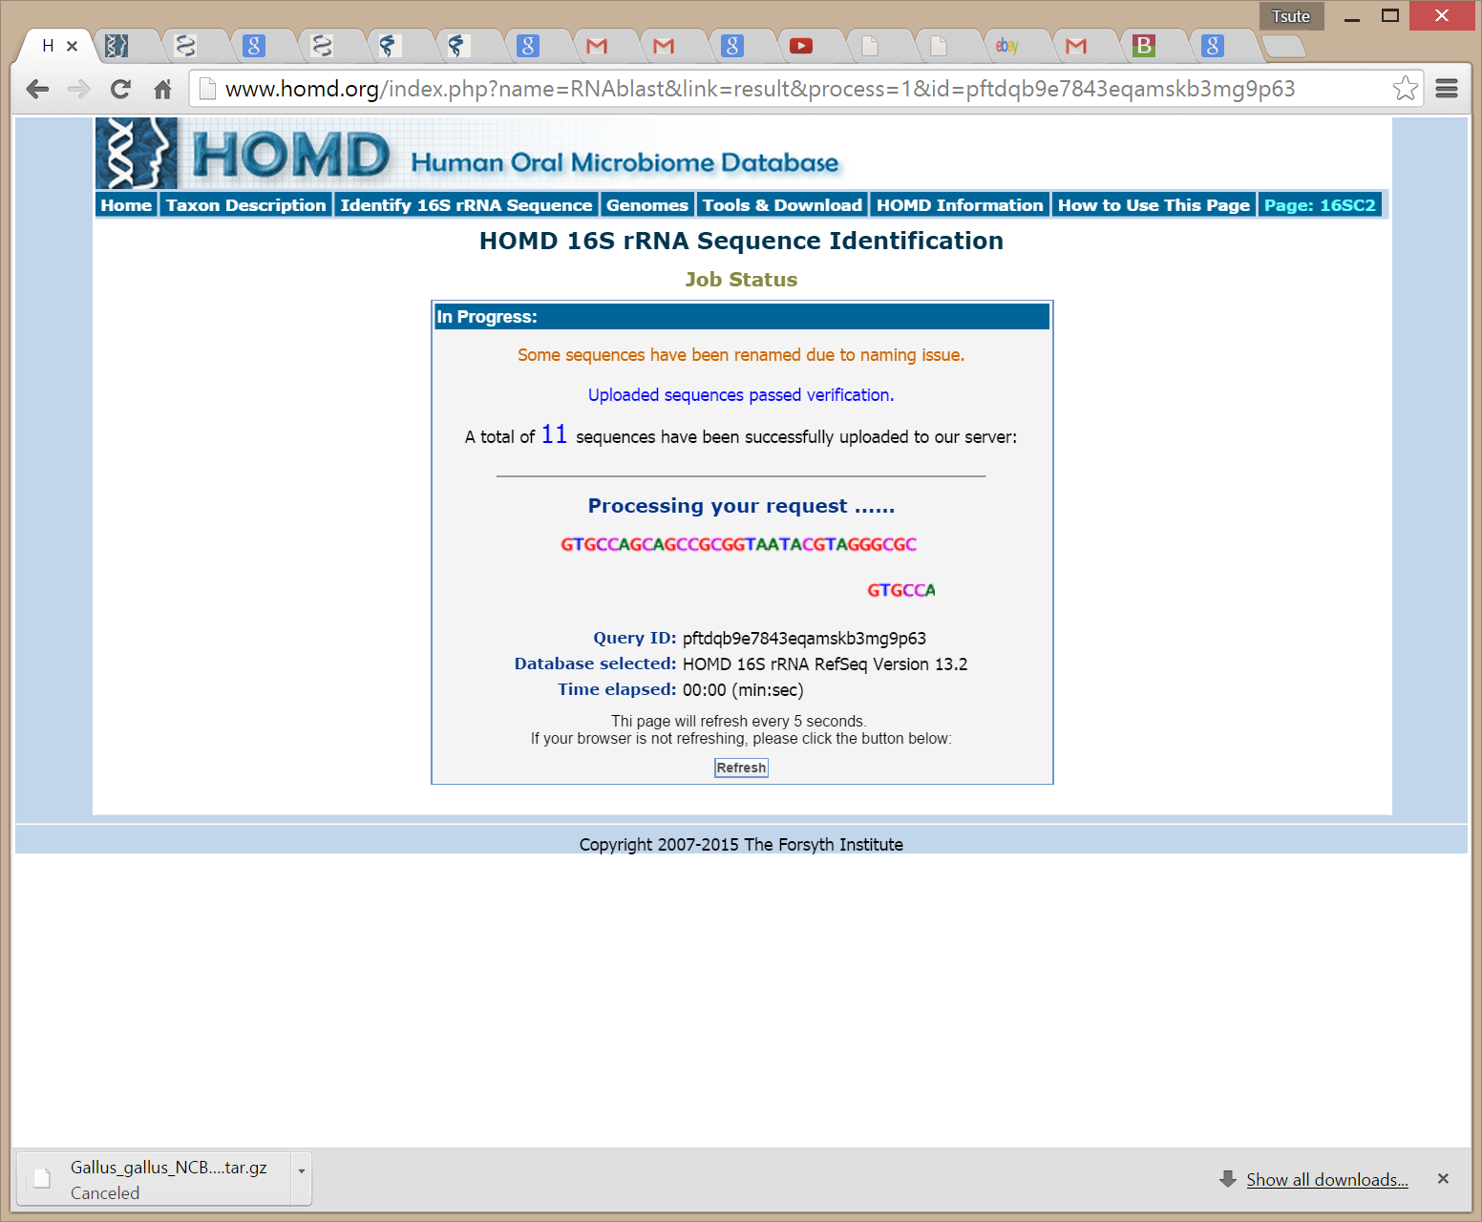

Slide 29
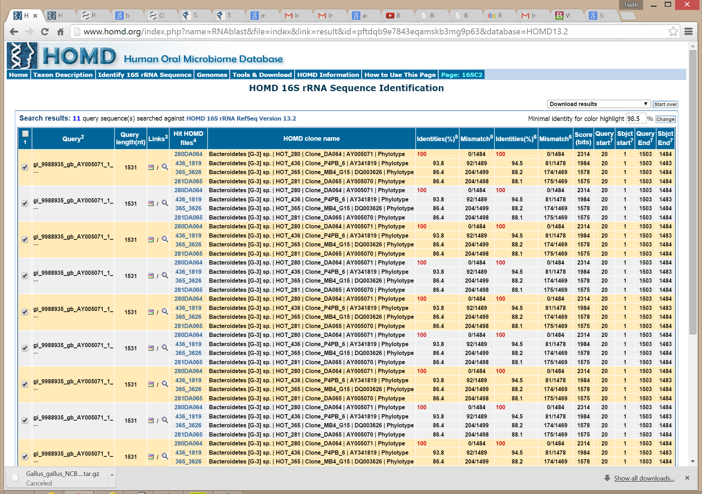

Slide 30
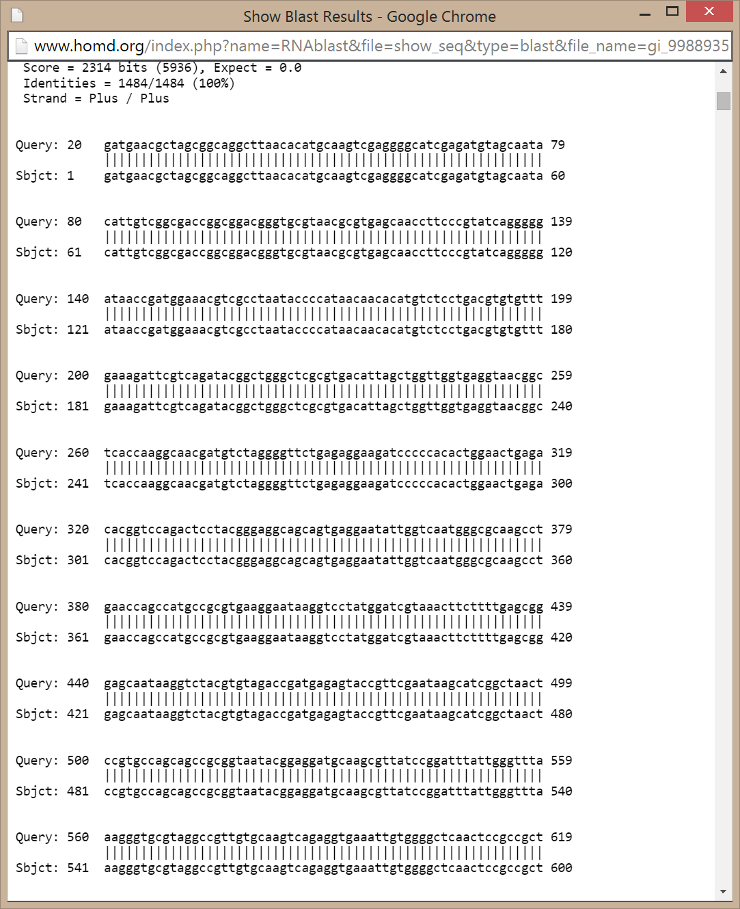

Slide 32
The HOMD 16S rRNA Reference Sequences
Current Version: 13.2
Total No. of Sequences: 831
Searchable on the HOMD web site
Downloadable from HOMD web site
Total No. of | in HOMD | In RefSeq
Domain | 2 | 1
Phylum | 16 | 13
Class | 30 | 23
Order | 47 | 39
Family | 90 | 82
Genus | 196 | 182
Species | 707 | 686
Notes:
009 Bacteria;Proteobacteria;Betaproteobacteria;Neisseriales;Neisseriaceae;Eikenella;sp. oral taxon 009
Archaea;Euryarchaeota;Methanobacteria;Methanobacteriales;Methanobacteriaceae;Methanobrevibacter;oralis
Treponema socranskii (HOT769)
Veillonella parvula (HOT161)

Slide 34
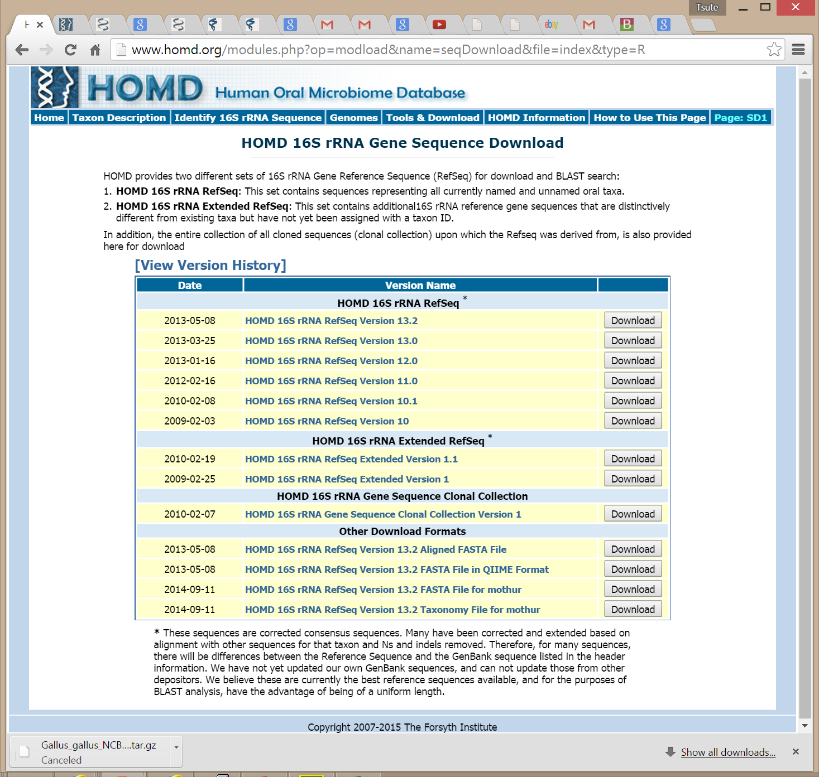

Slide 36
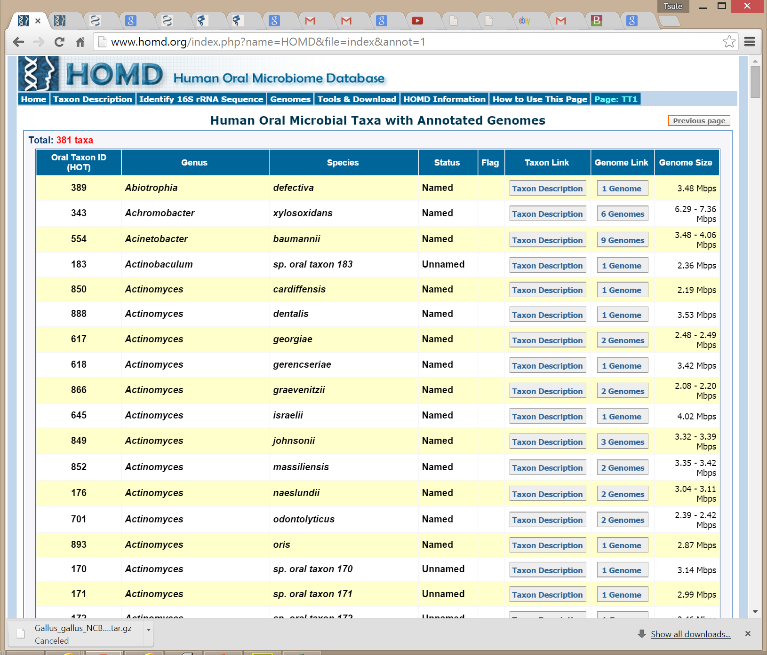

Slide 38
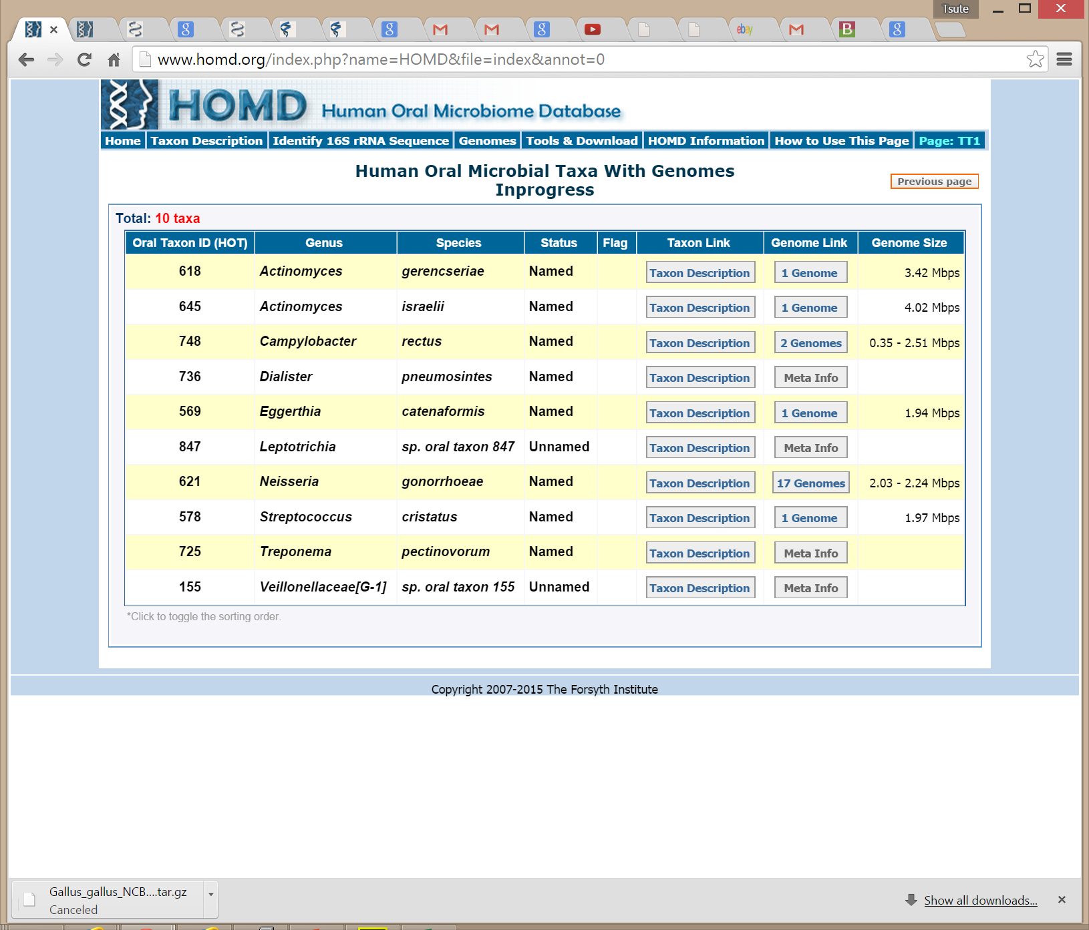

Slide 39
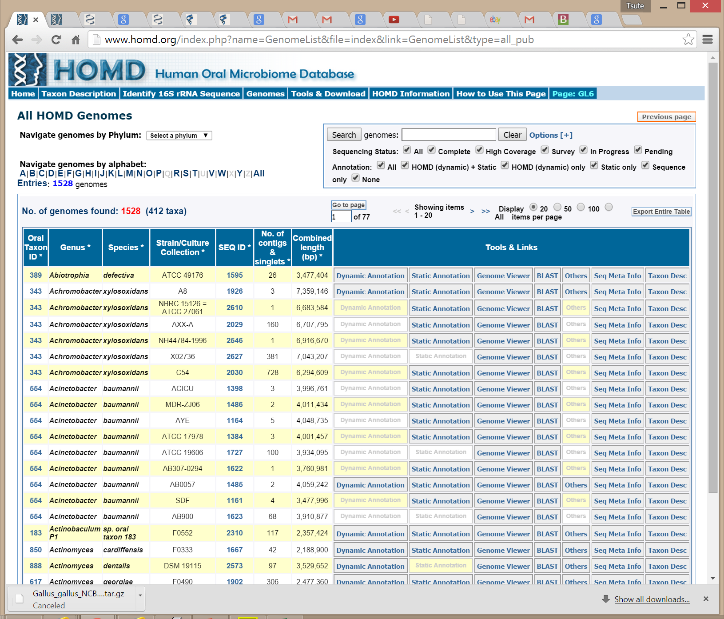

Slide 40
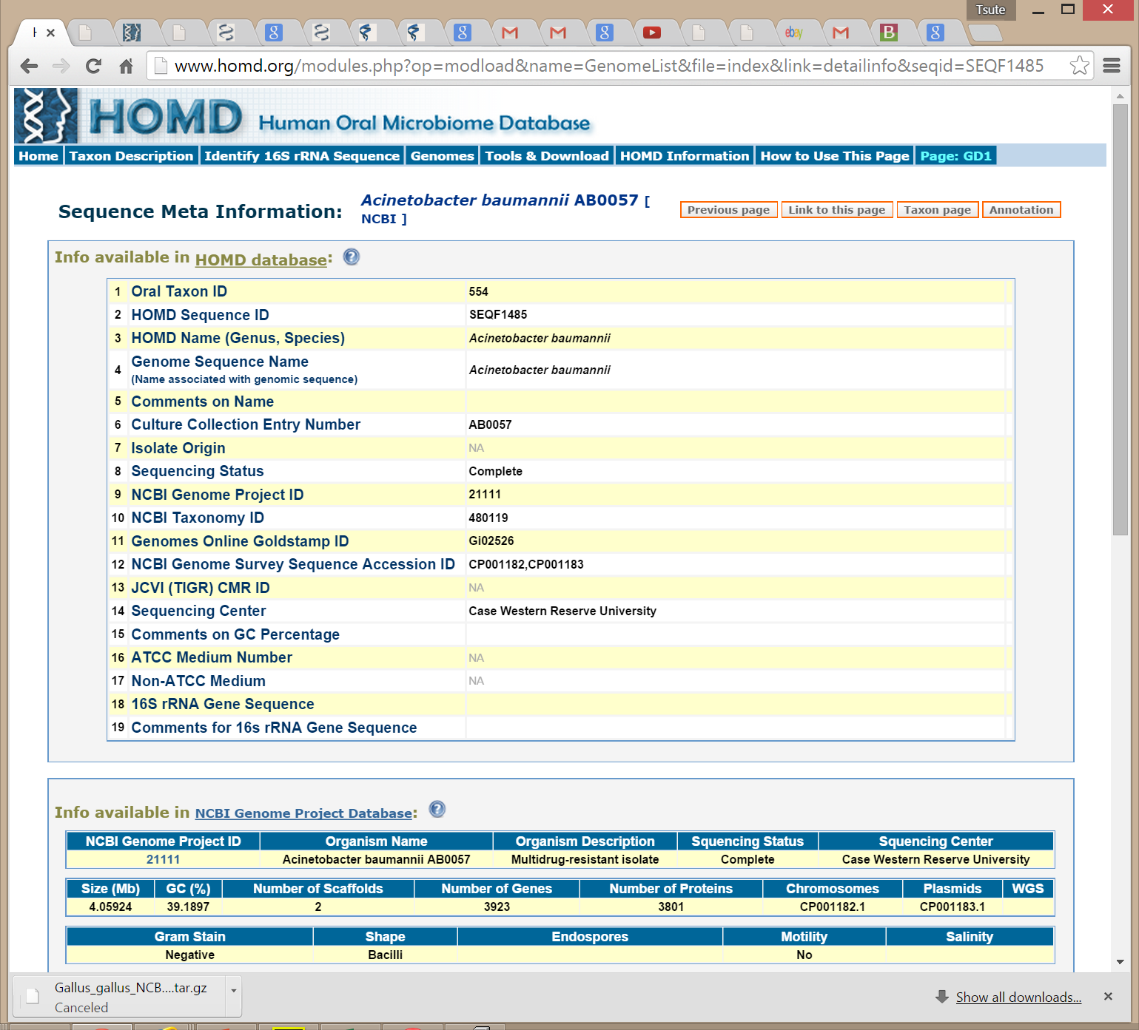

Slide 42
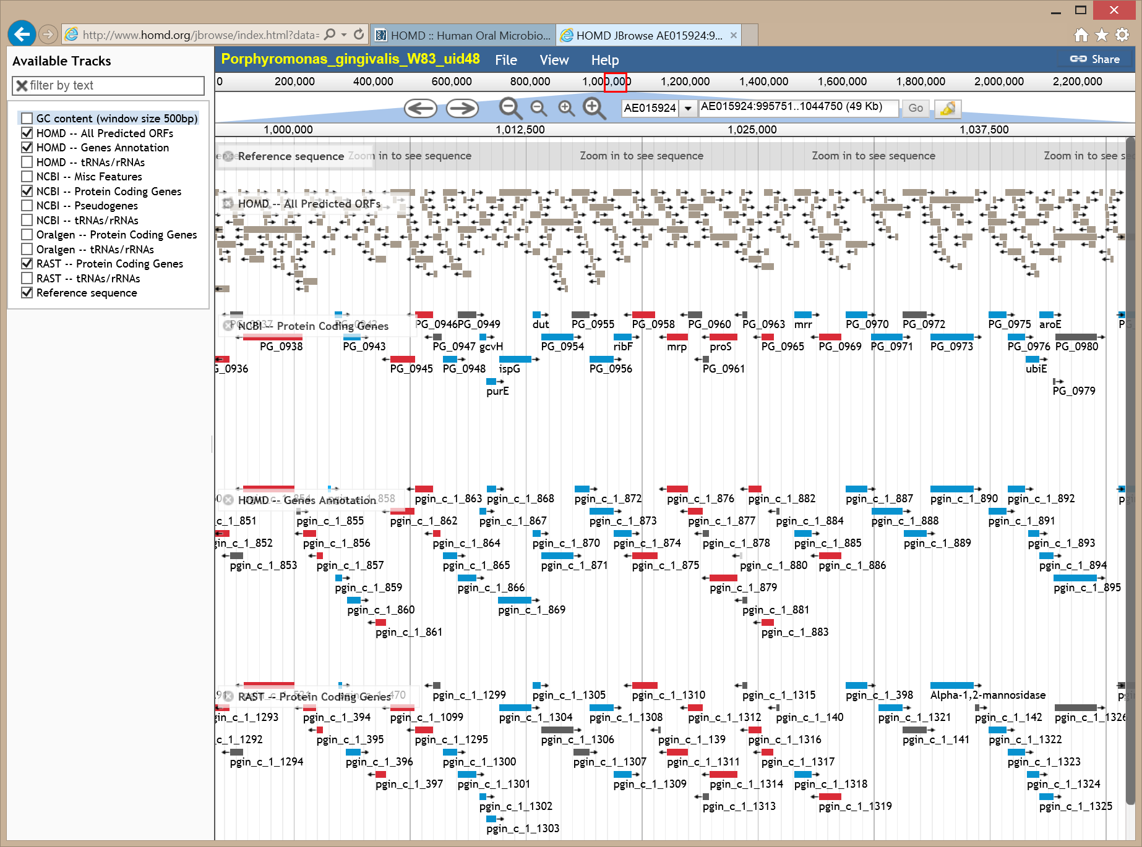

Slide 43
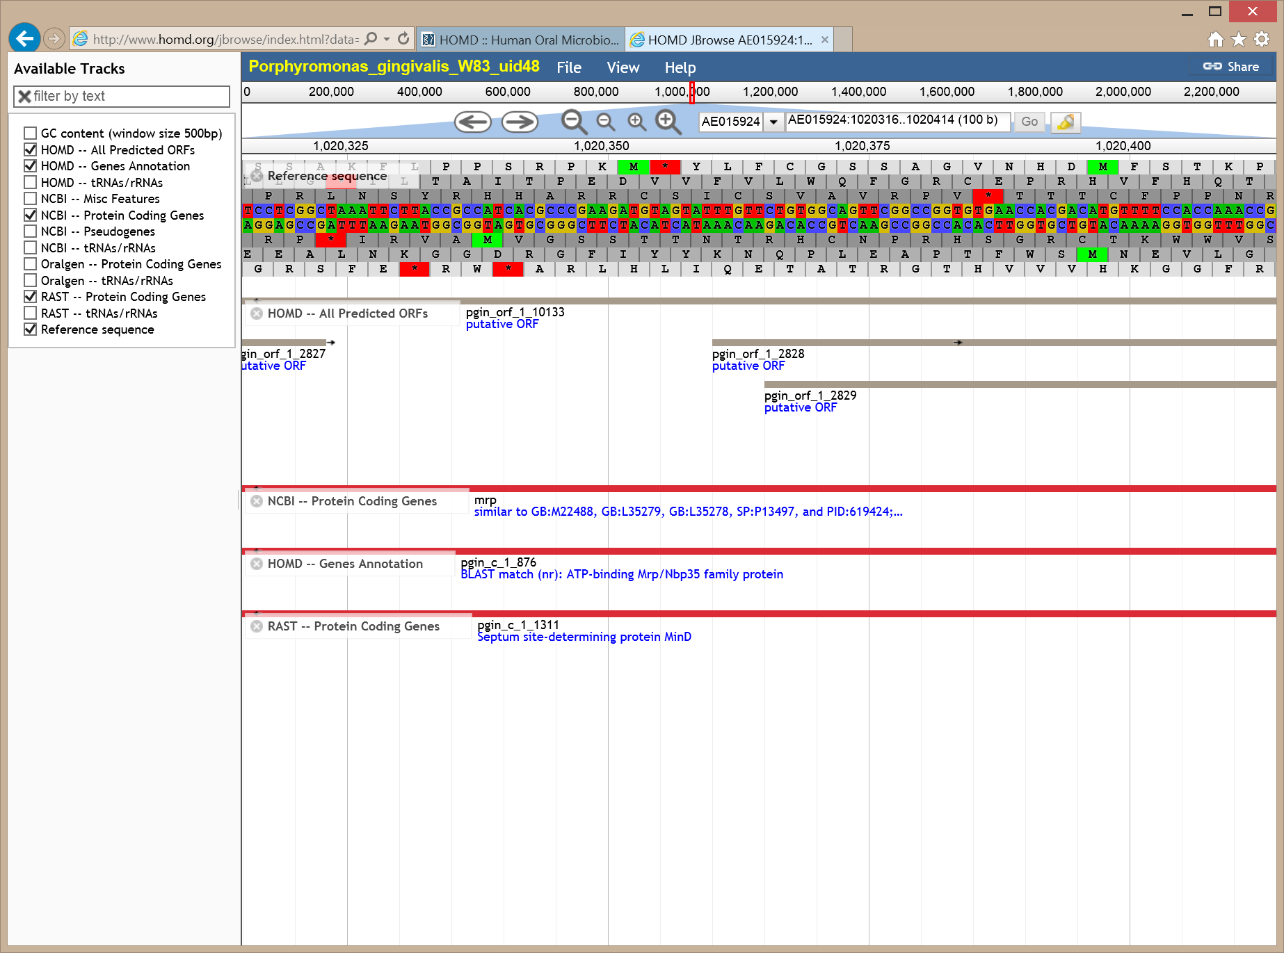

Slide 44
Jbrowse Genome Viewer at HOMD
Upload your own genome annotation
Your own NGS sequencing data, e.g. RNAseq, ChIP, small RNA, etc
Any microbial genomes

Slide 46
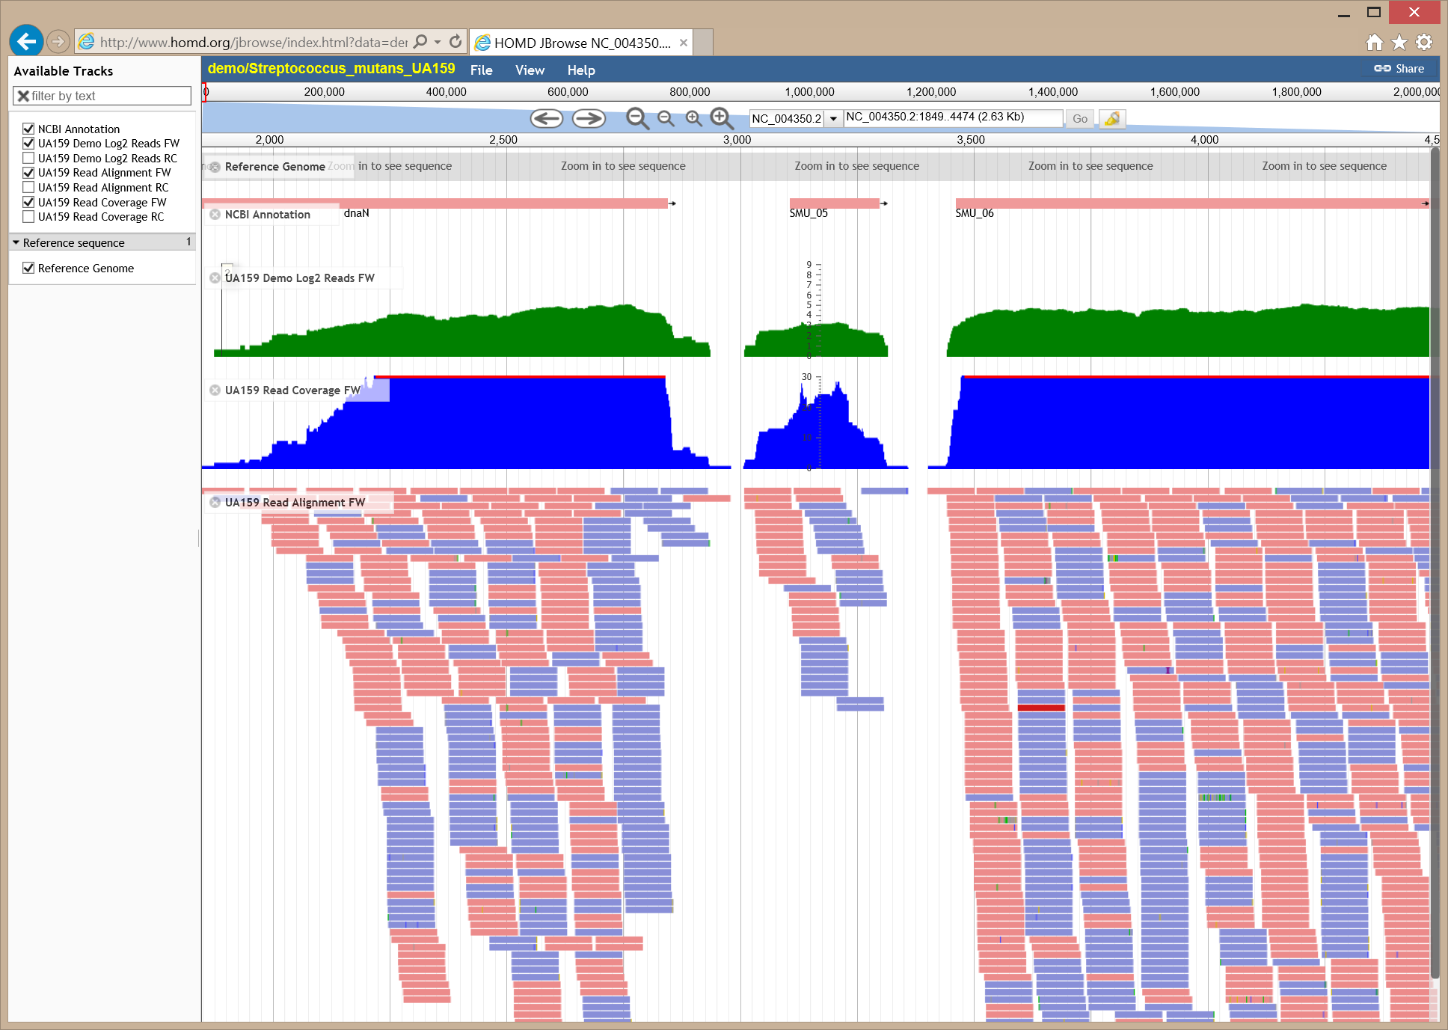

Slide 49
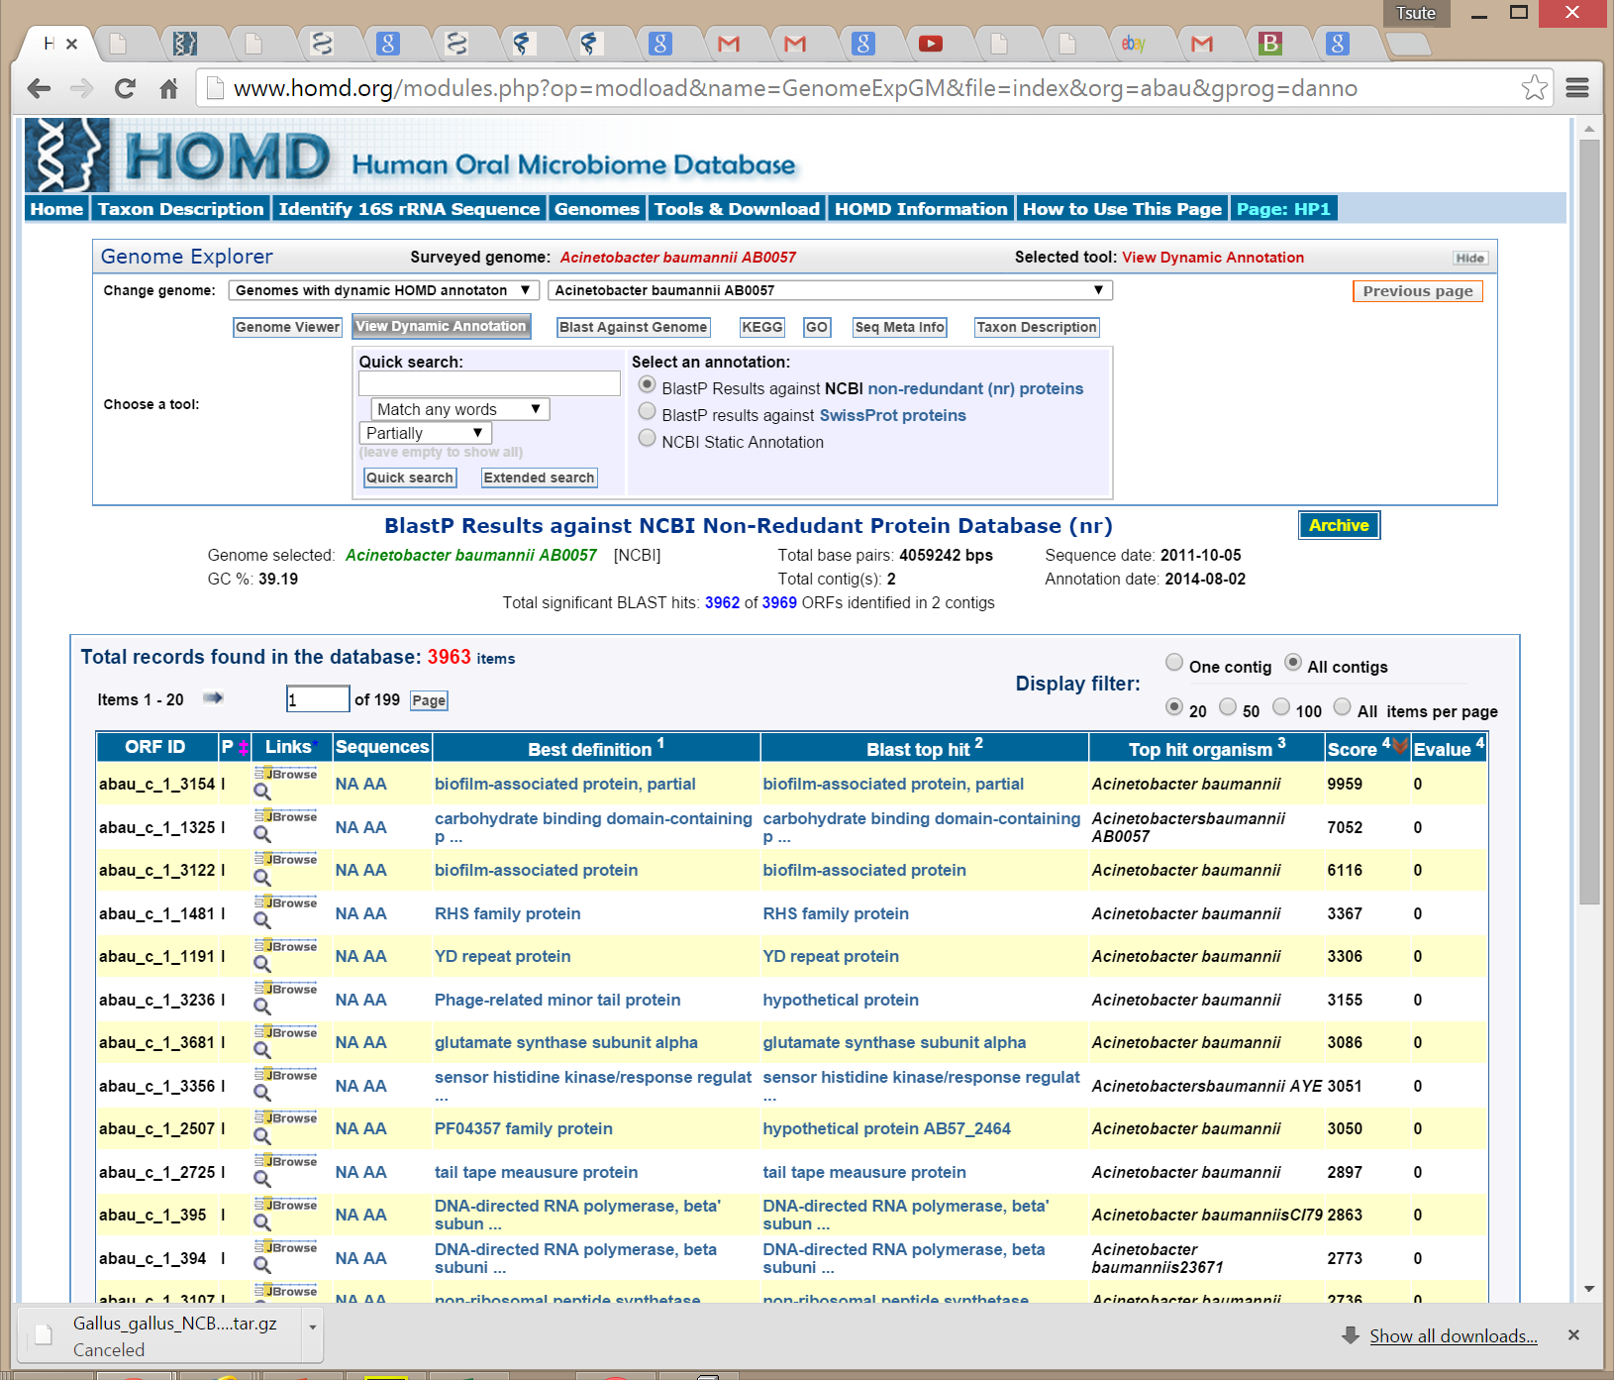

Slide 50
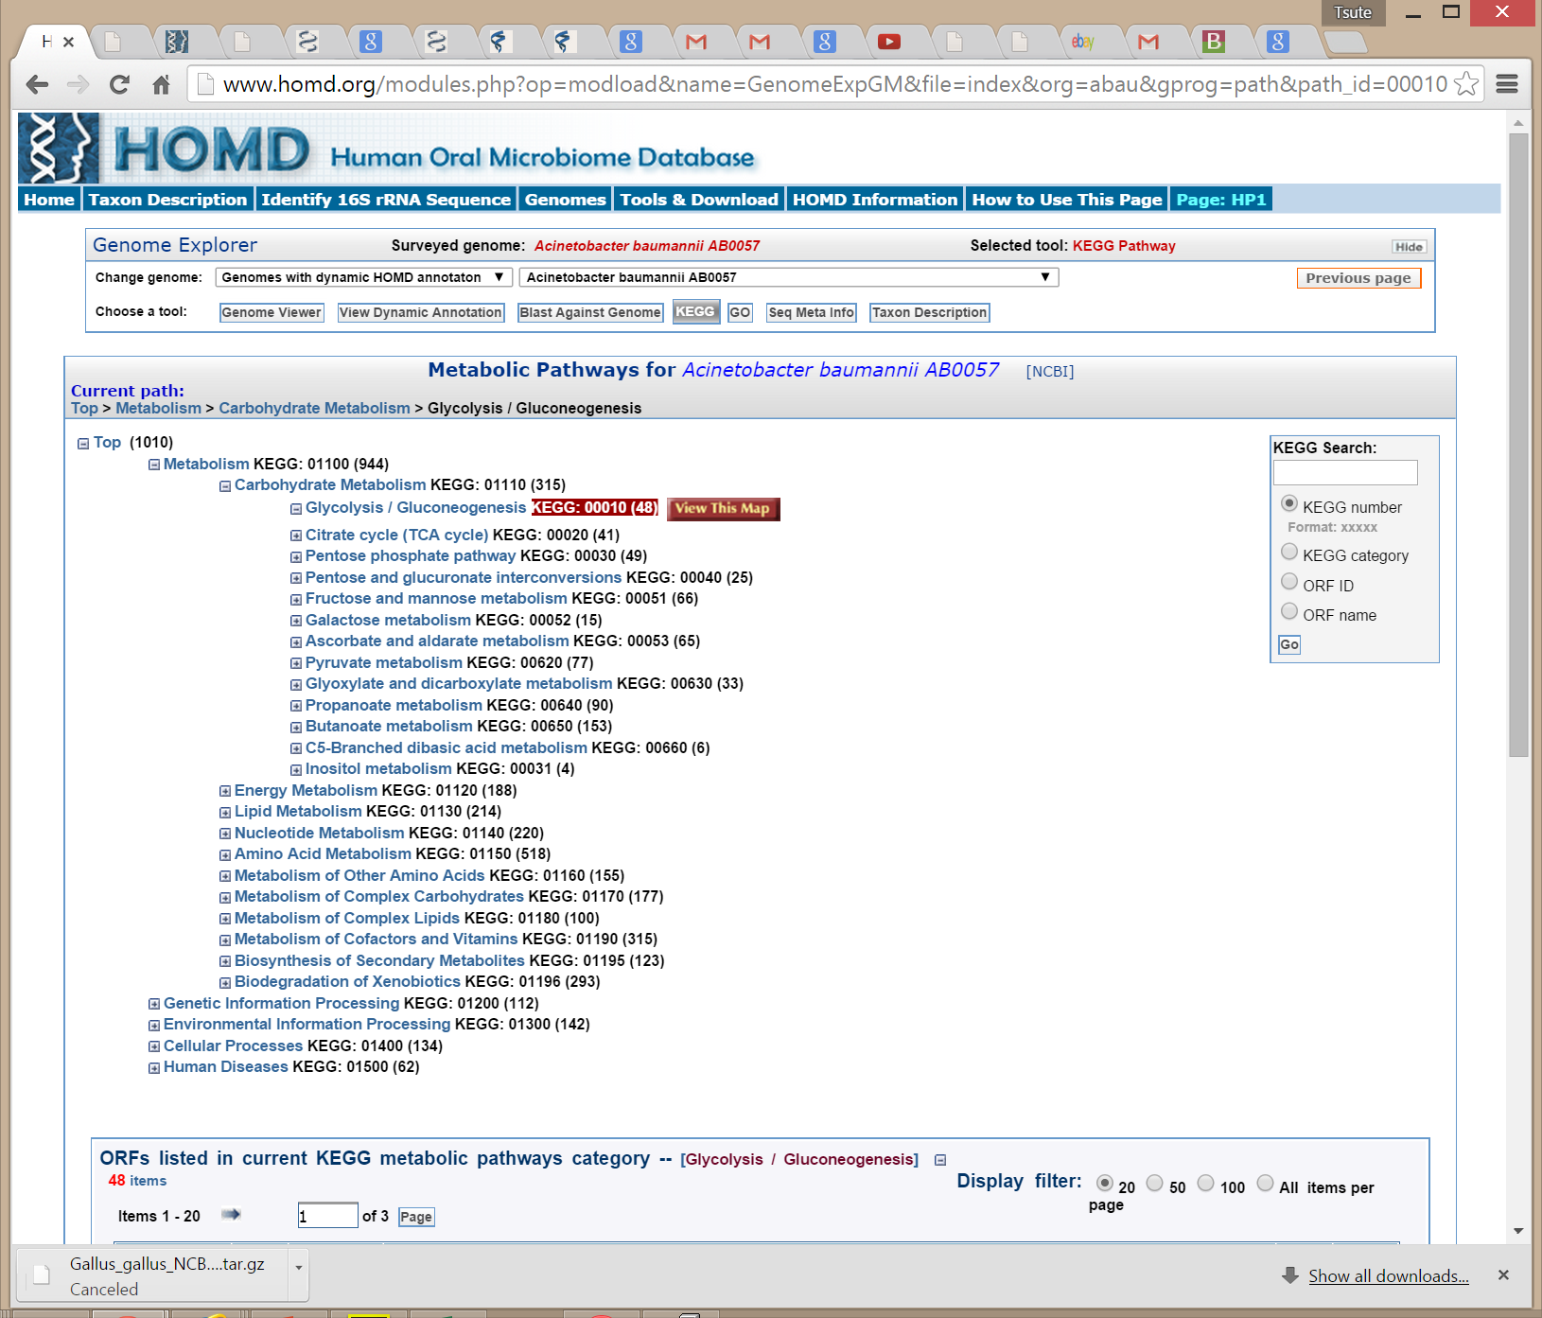

Slide 51
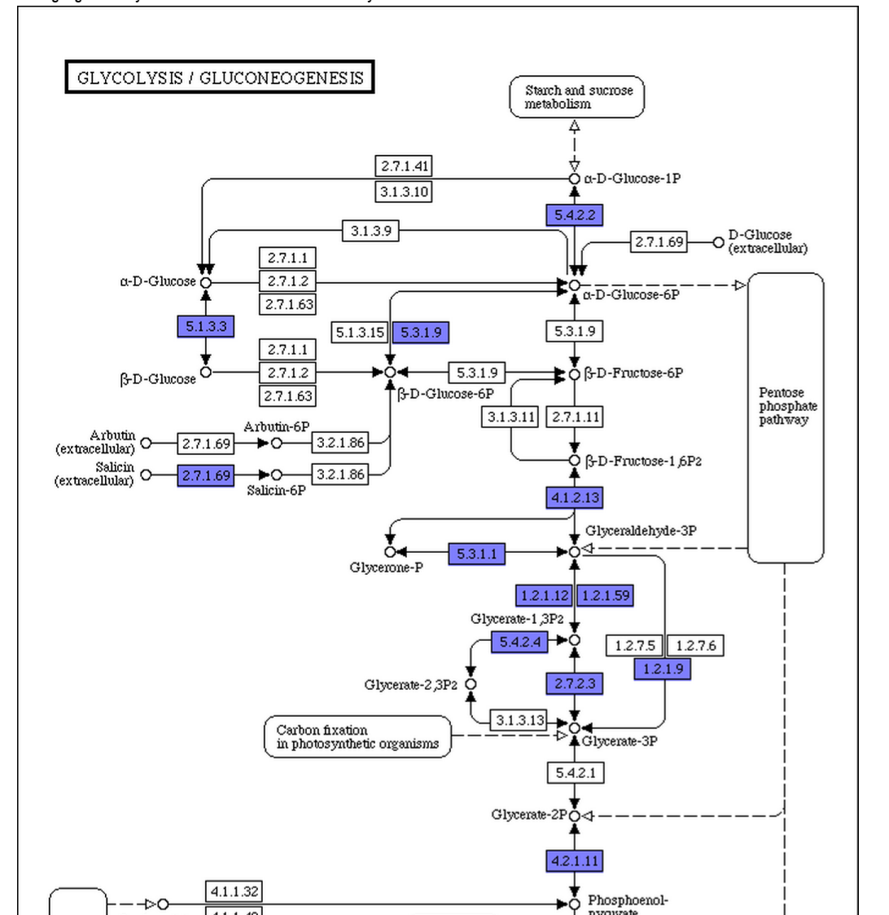

Slide 52
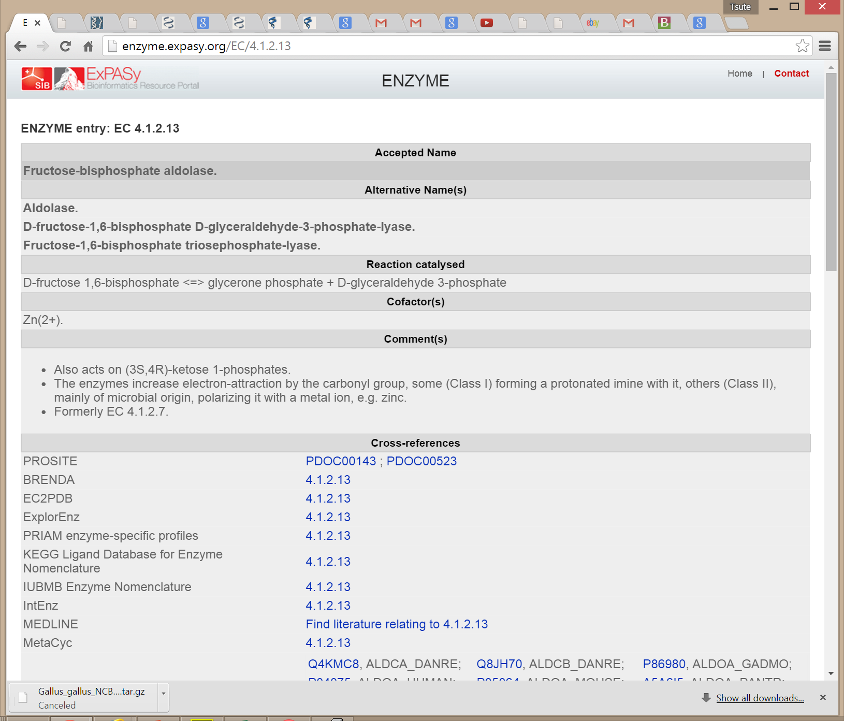

Slide 53
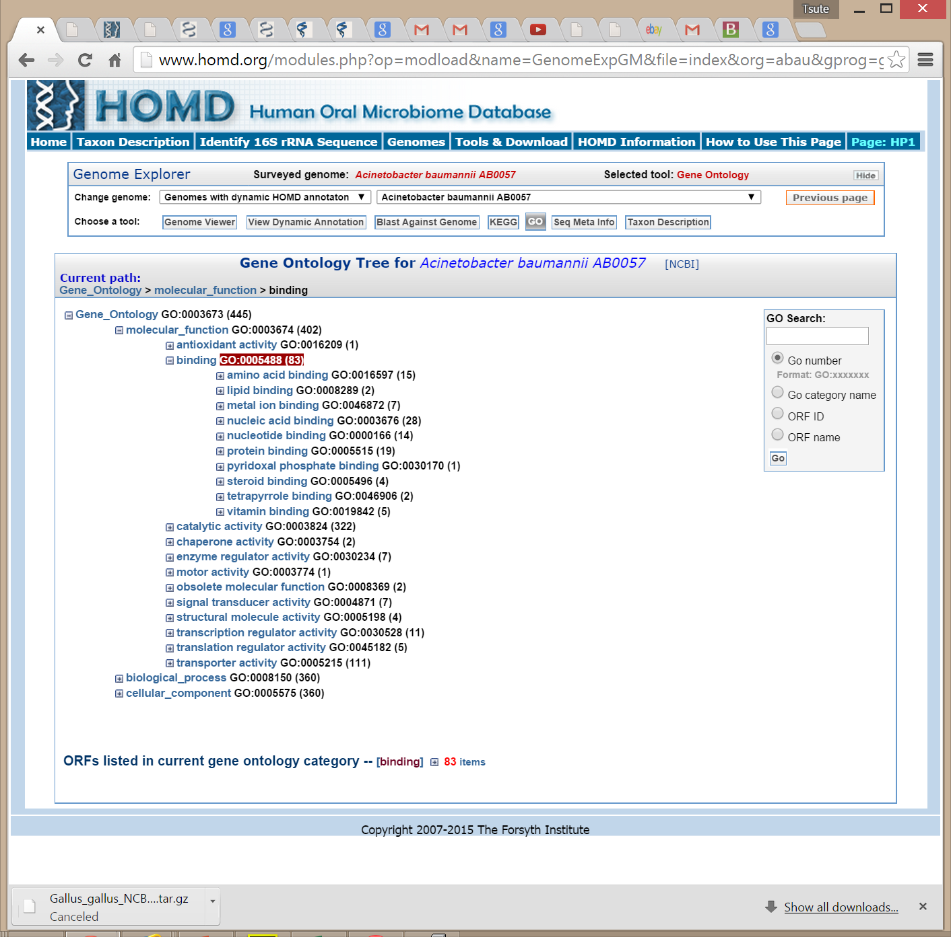

Slide 55
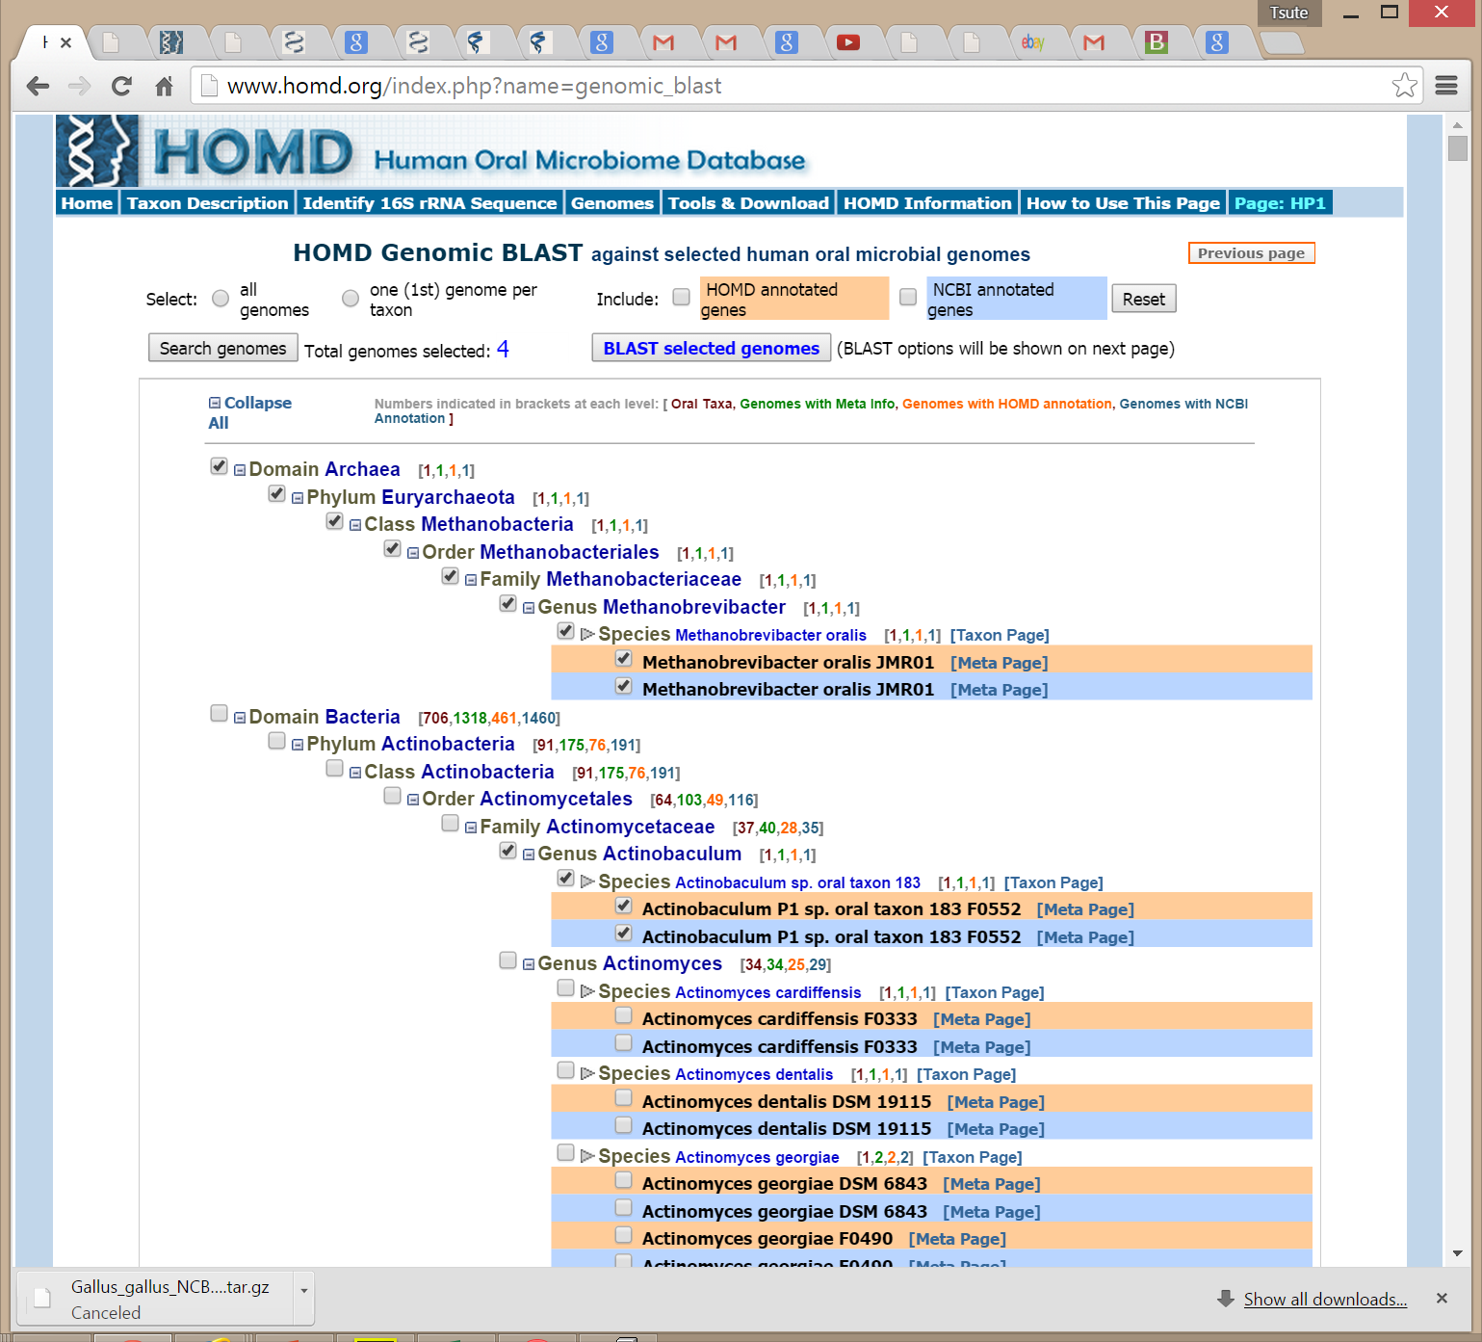

Slide 56
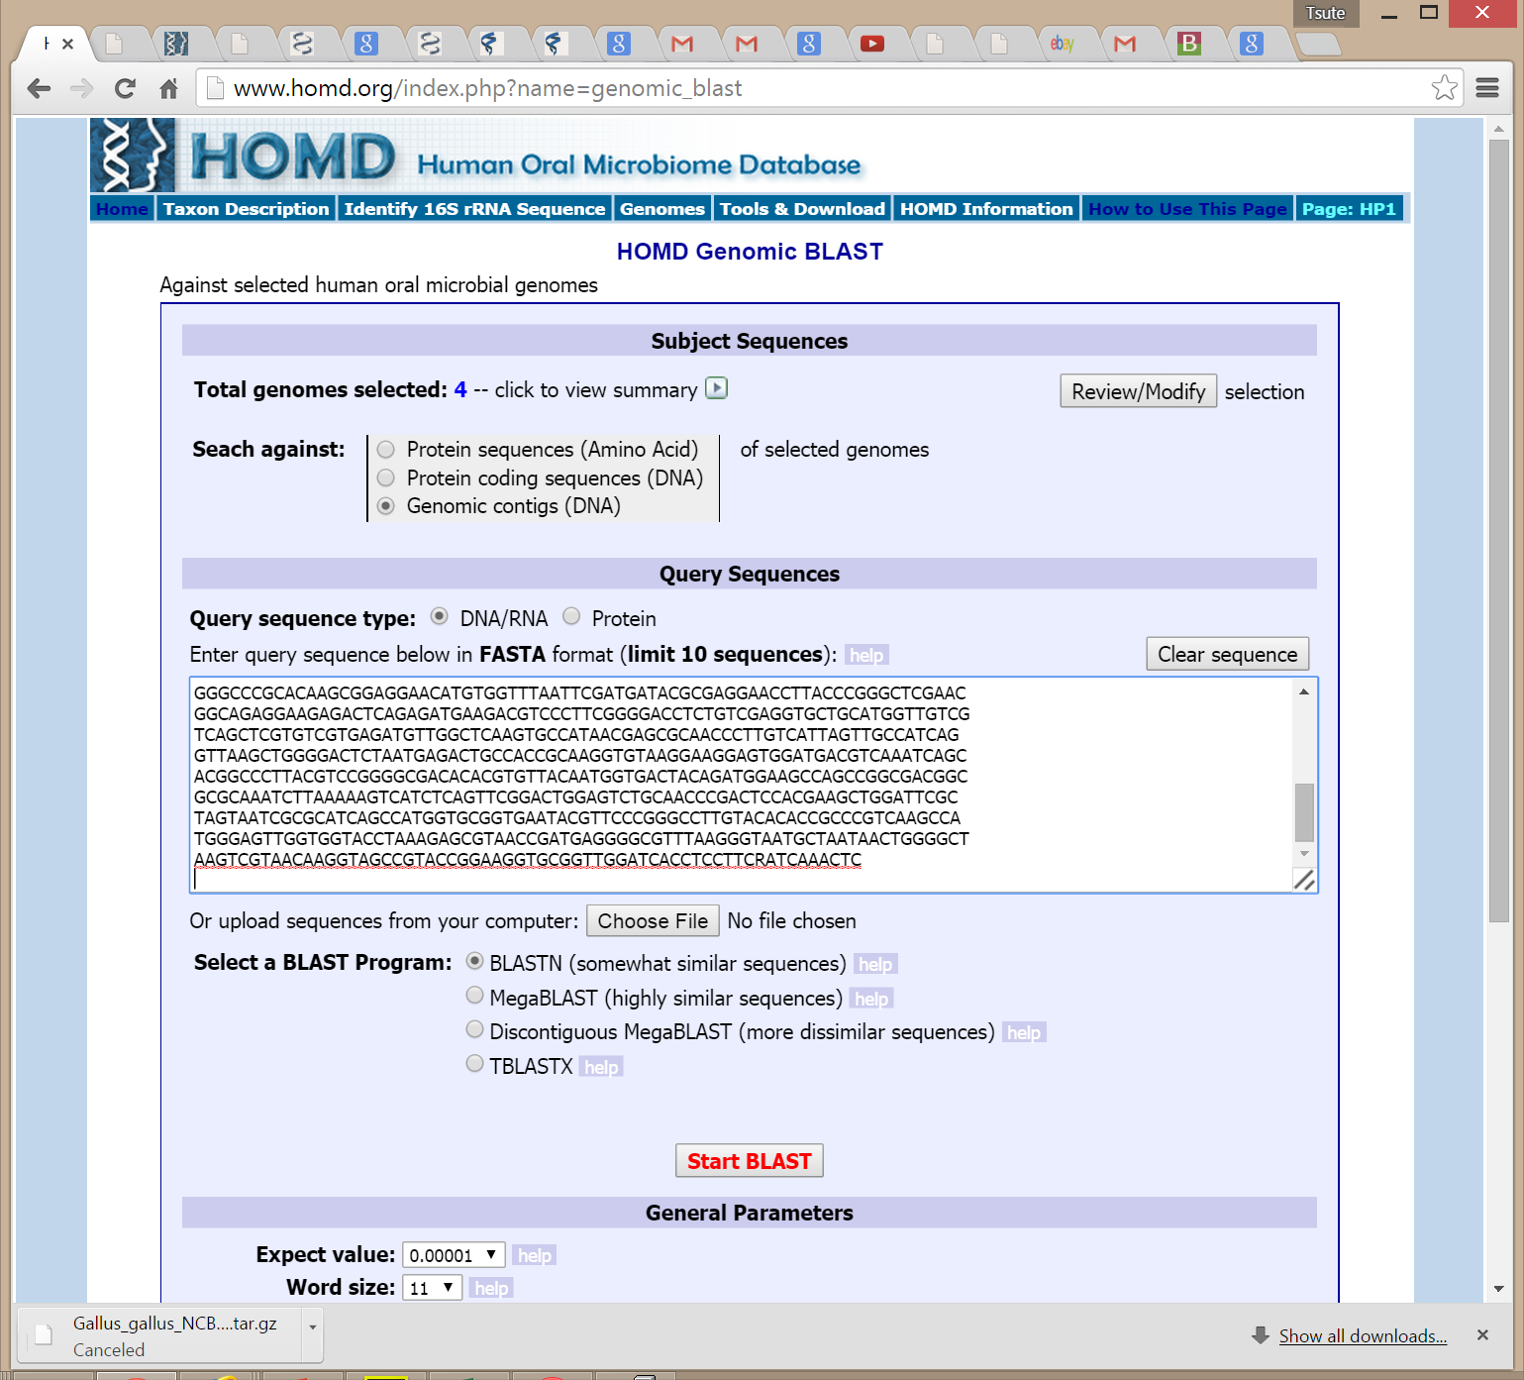

Slide 57
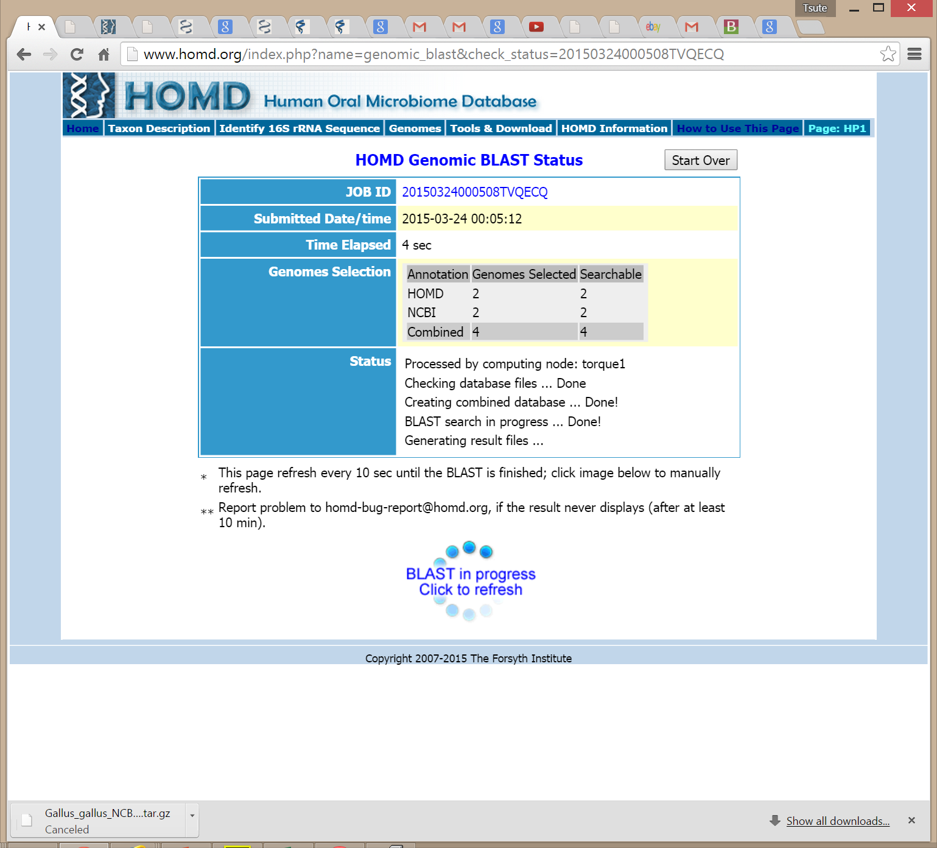

Slide 58
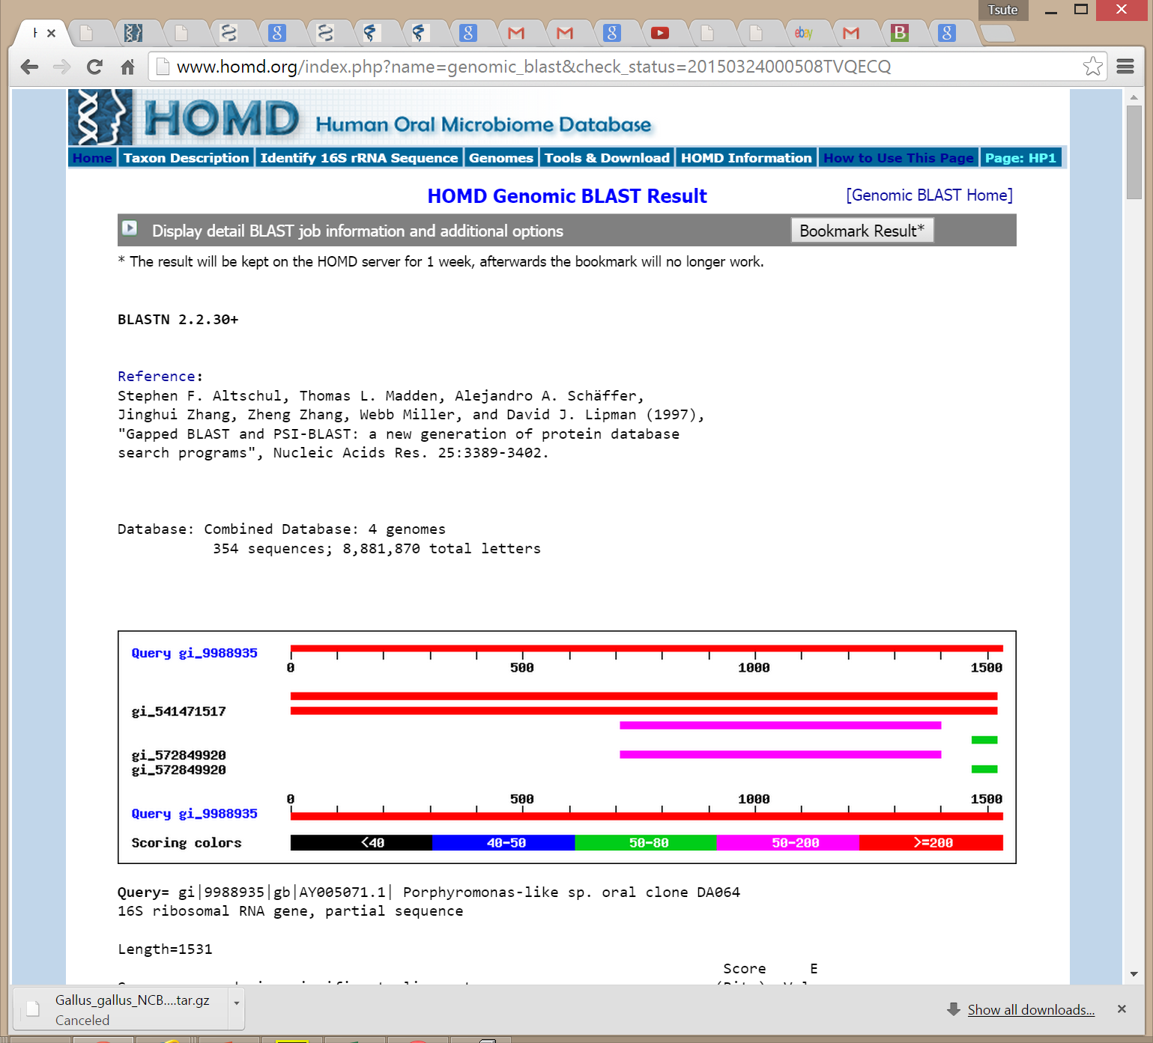

Slide 59
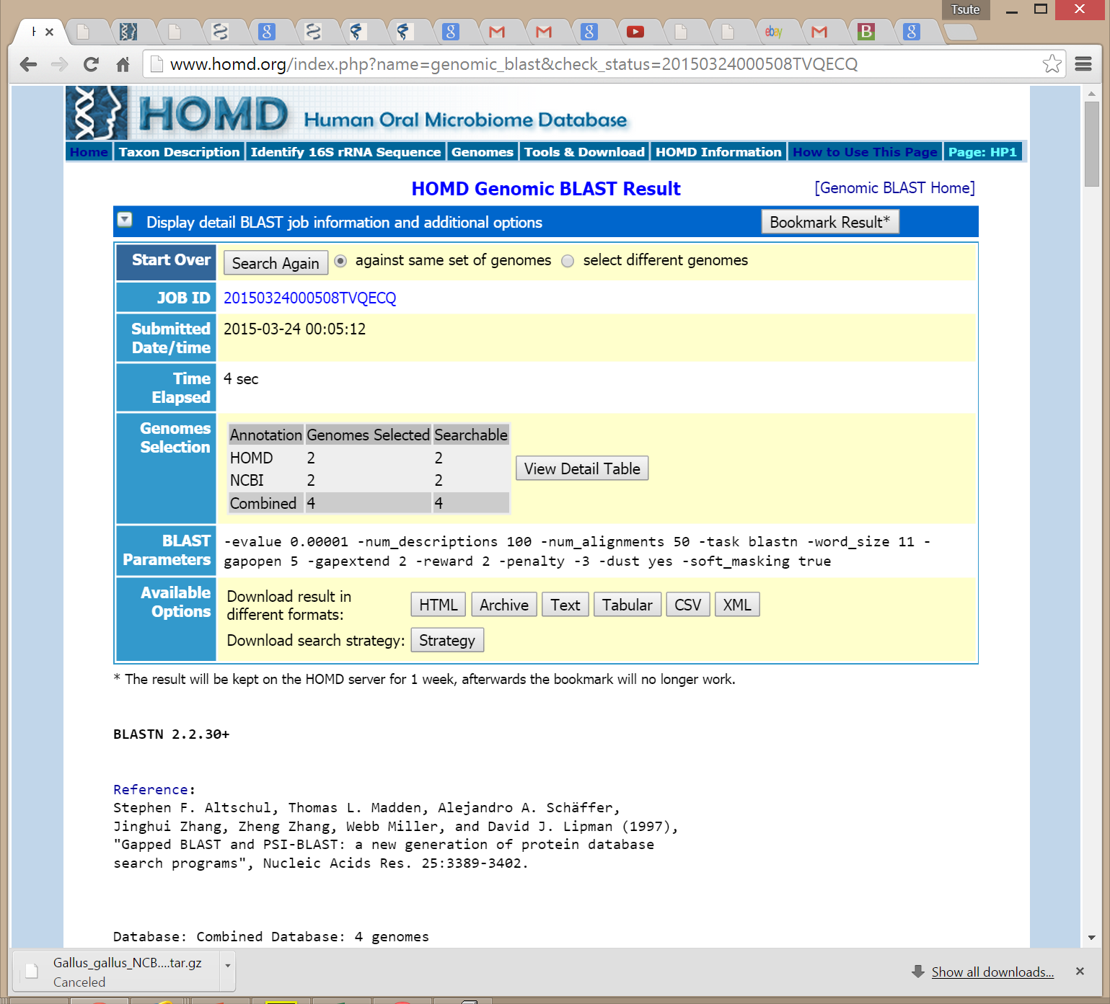

Slide 61
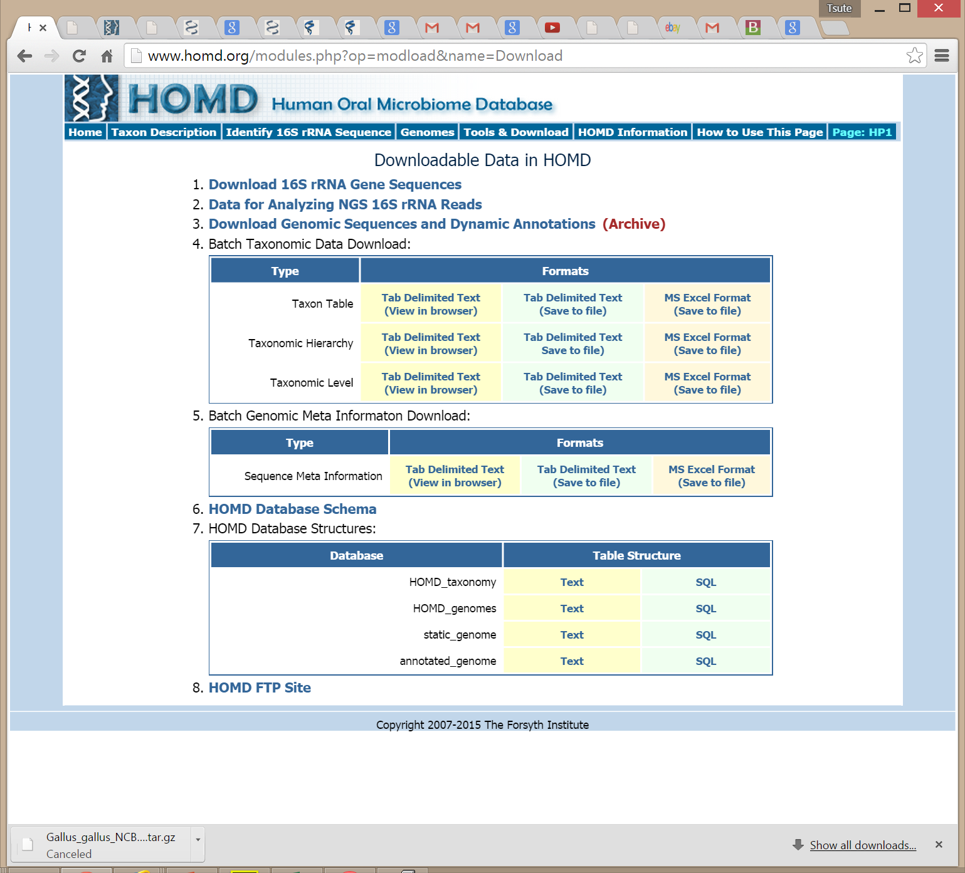

Slide 62
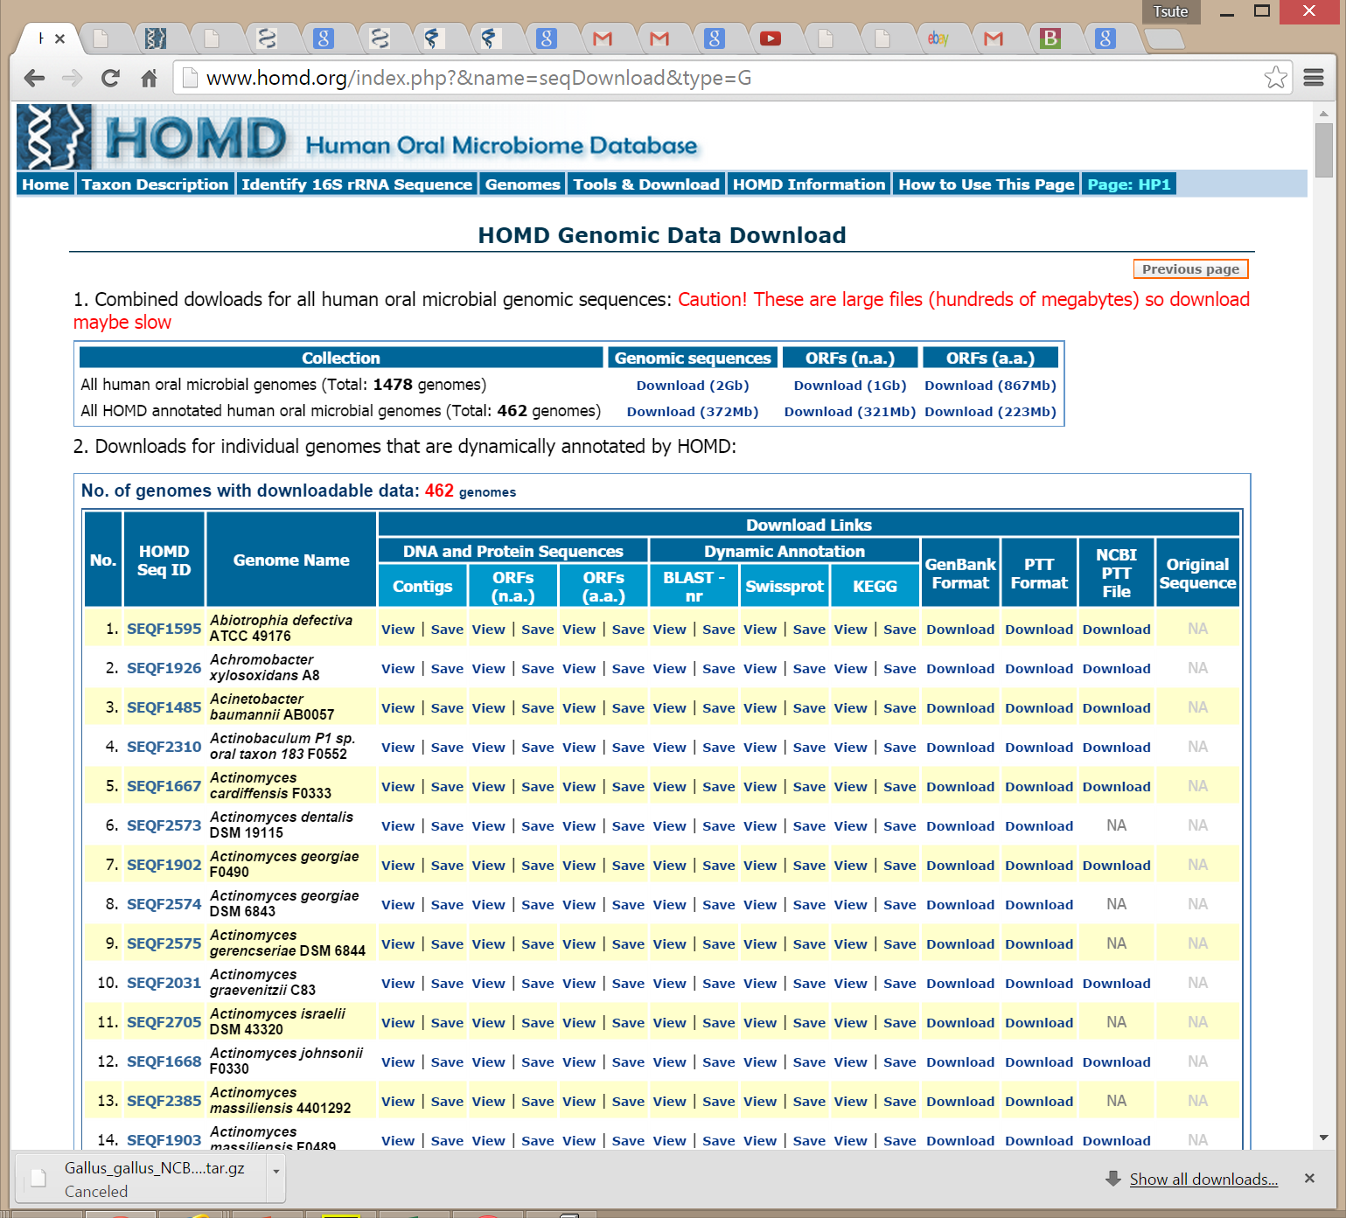

Slide 64
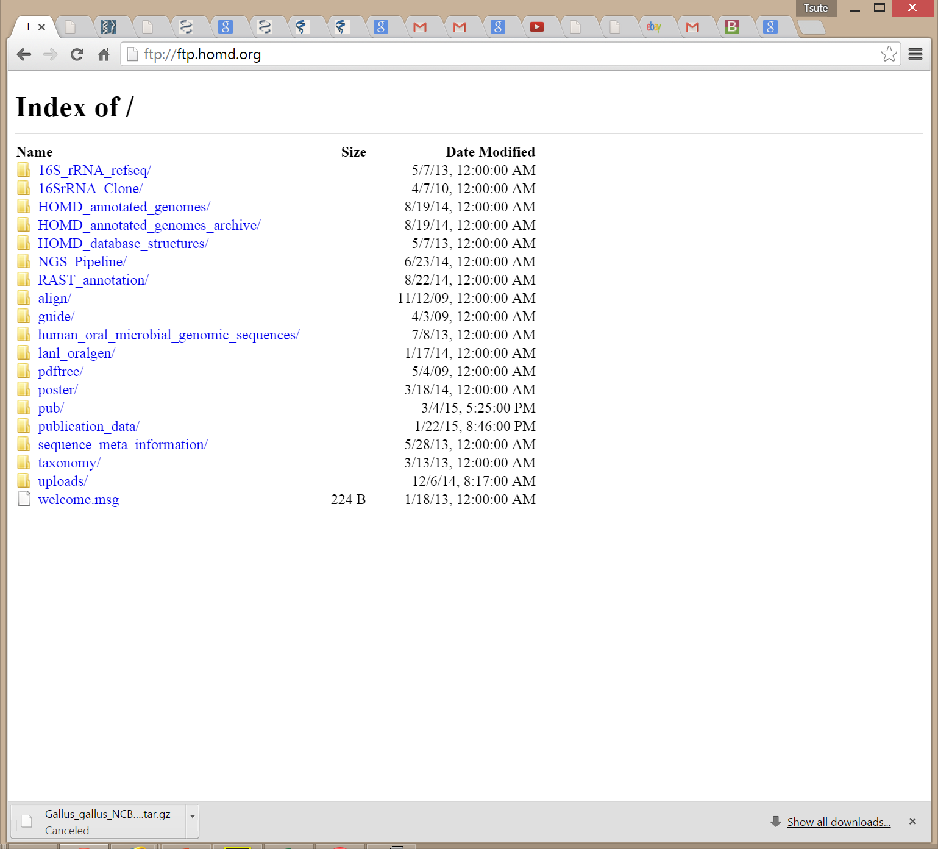

Slide 65
Future Plan
Continue taxonomy curation
More 16S rRNA reference sequences
More genomes
More software tools and analysis pipelines
Improve back-end computational power
Cloud platform for analysizing NGS sequences

Slide 66
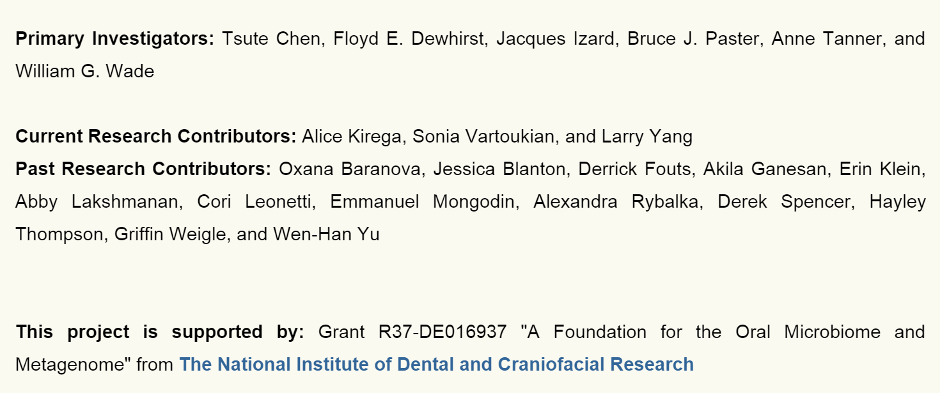
Acknowledgement

